Slide 1
Employee engagement in a covid-19 world
SHARON RAMALHO

Slide 2
we are not working from home…
we are at home, during a crisis, trying to work

Slide 3

How do we lead through this?

Slide 4
What steps can you take to ensure employees remain engaged?

Slide 5
Routines
Environment
Communication
Open Doors
Virtual Meetings
Encouragement
Re-build Plans
You

Slide 6
Routines
Environment
Communication
Open Doors
Virtual Meetings
Encouragement
Re-build Plans
You

Slide 7
Free stuff

Slide 8


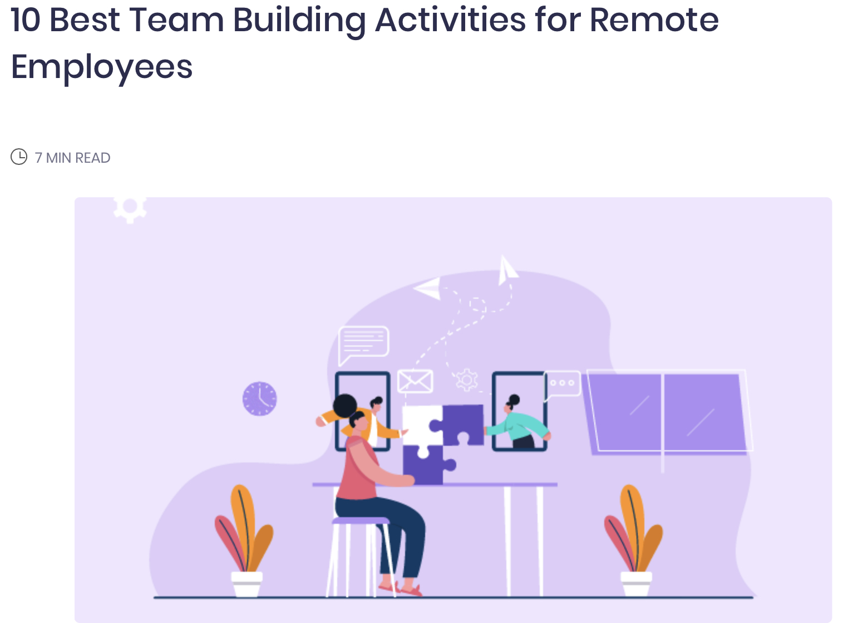


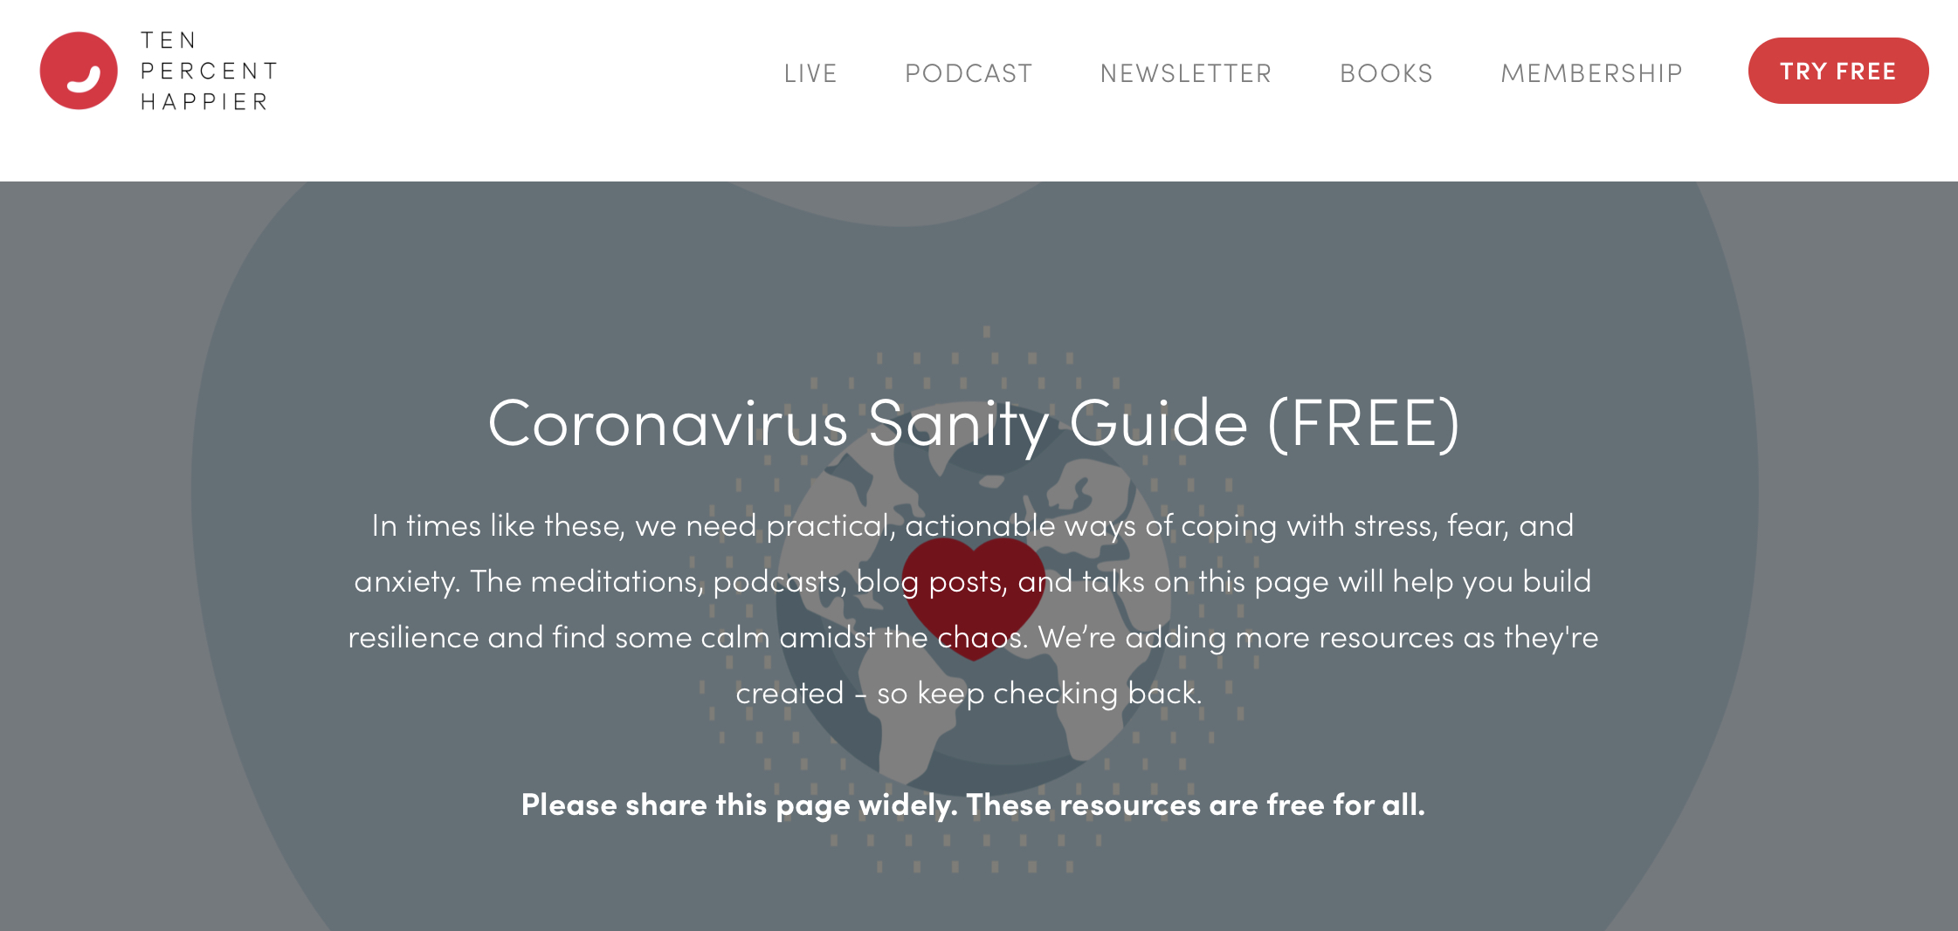

free stuff

Slide 9
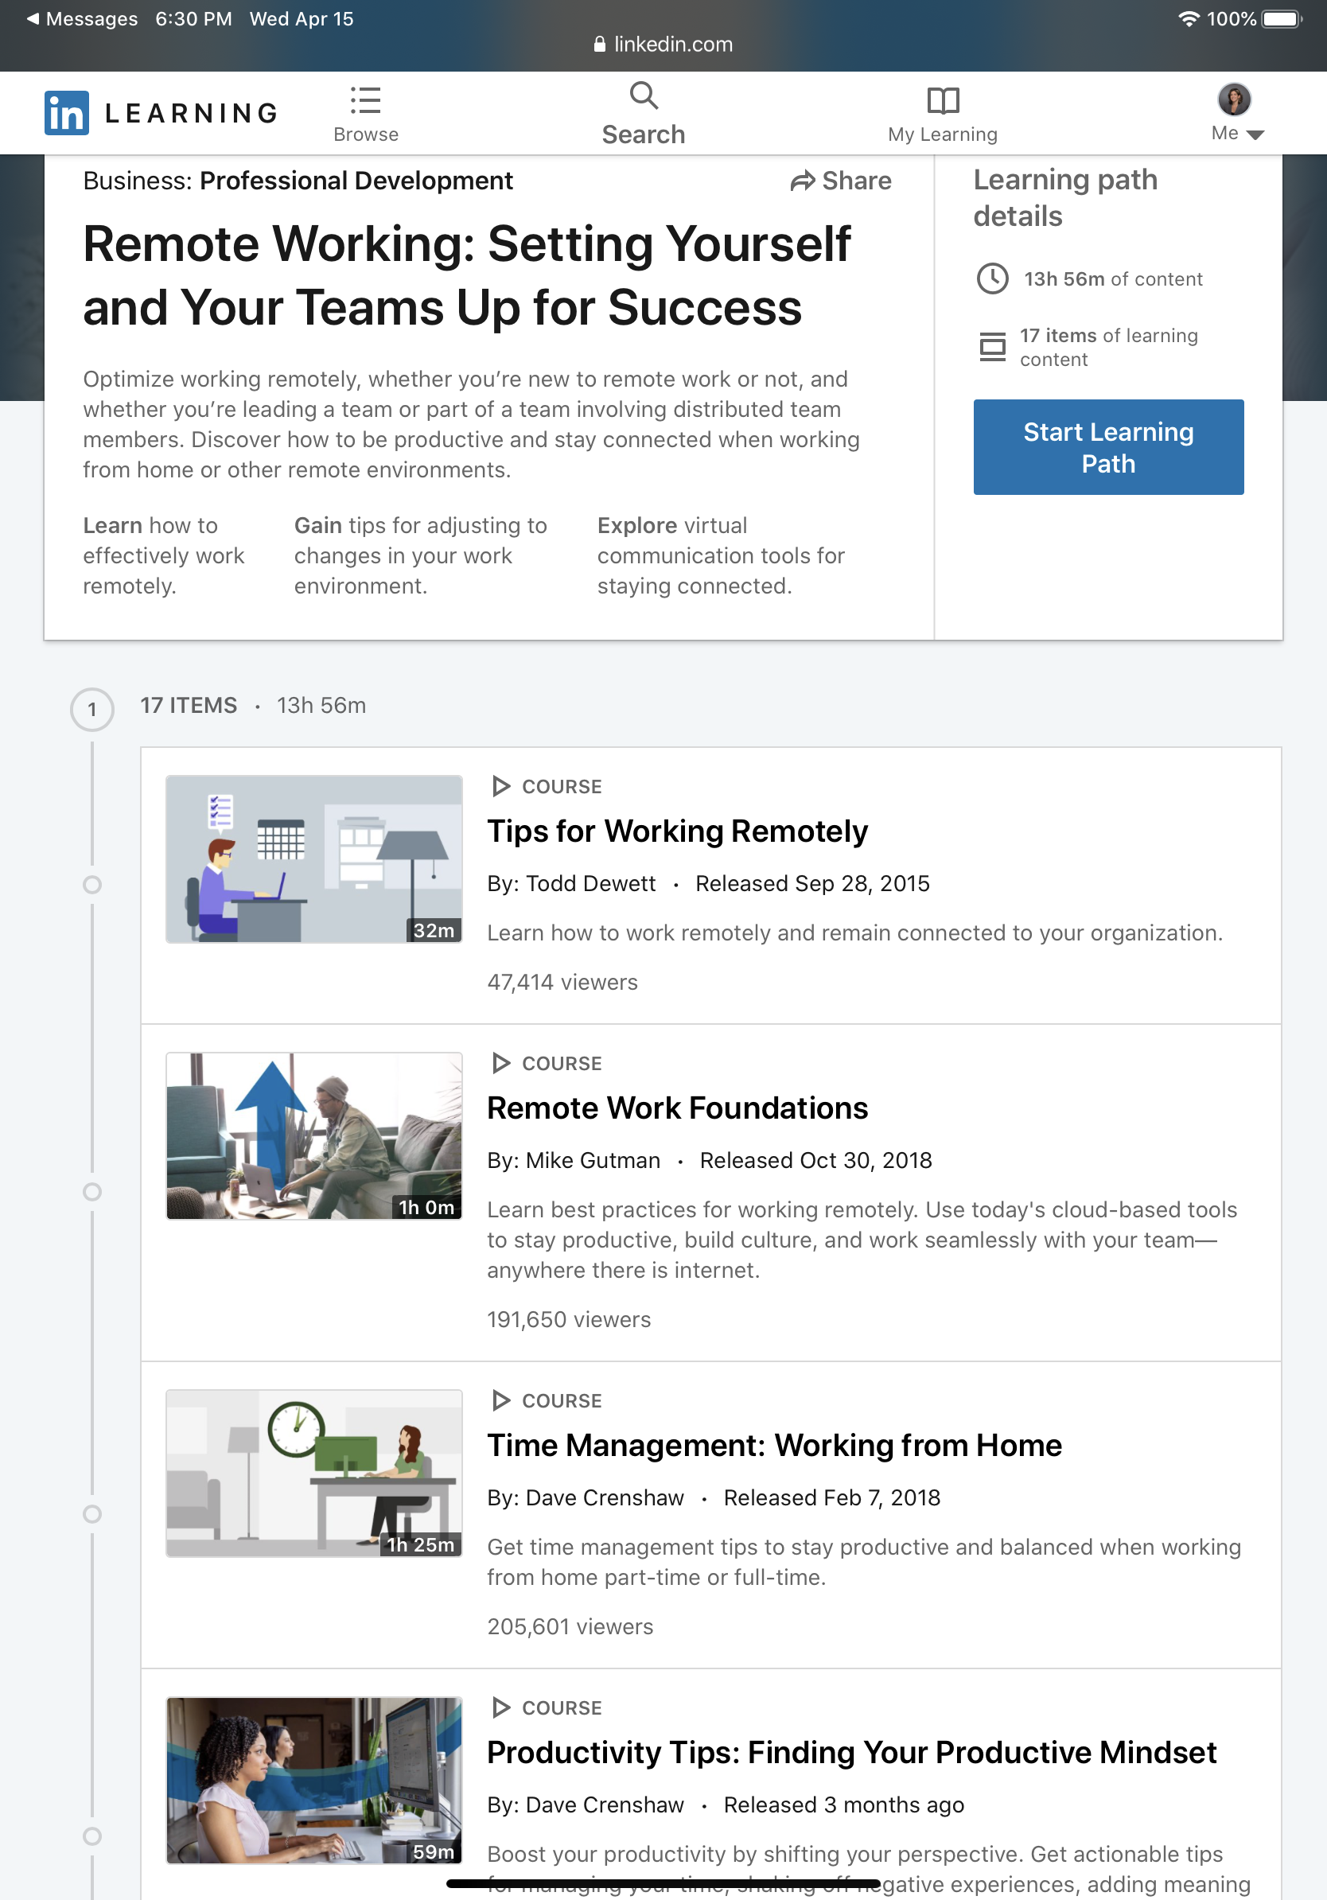


More Free stuff

Slide 10
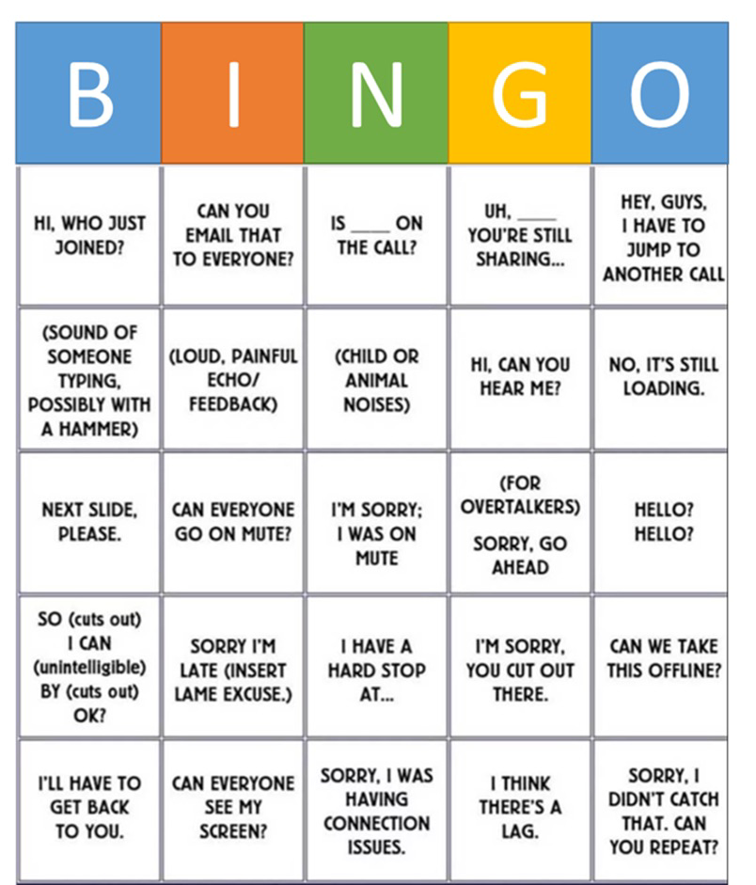
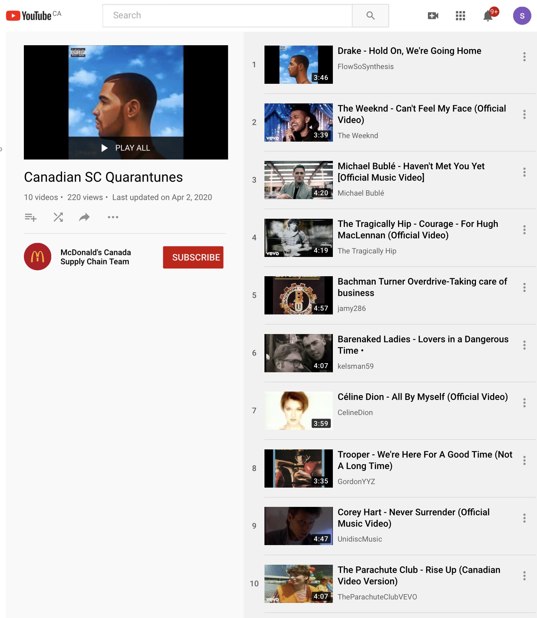

fun stuff

Slide 11


“You can’t do it without People”

Slide 12

Sharon Ramalho
sharon@six-words.com
www.six-words.com

