Slide 1
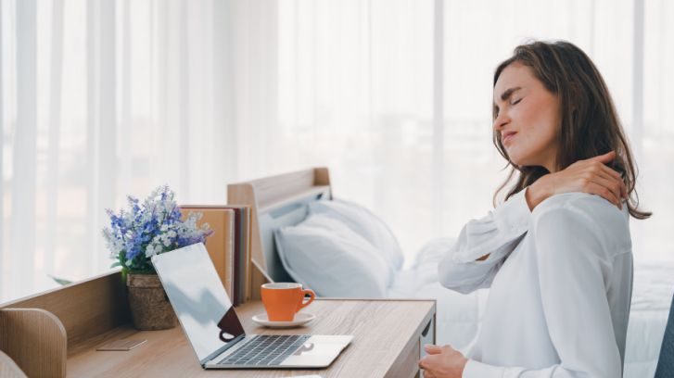
Helping Employees Manage Pain and Stay Healthy in a Remote World
By Alex Gurba PT

Slide 2
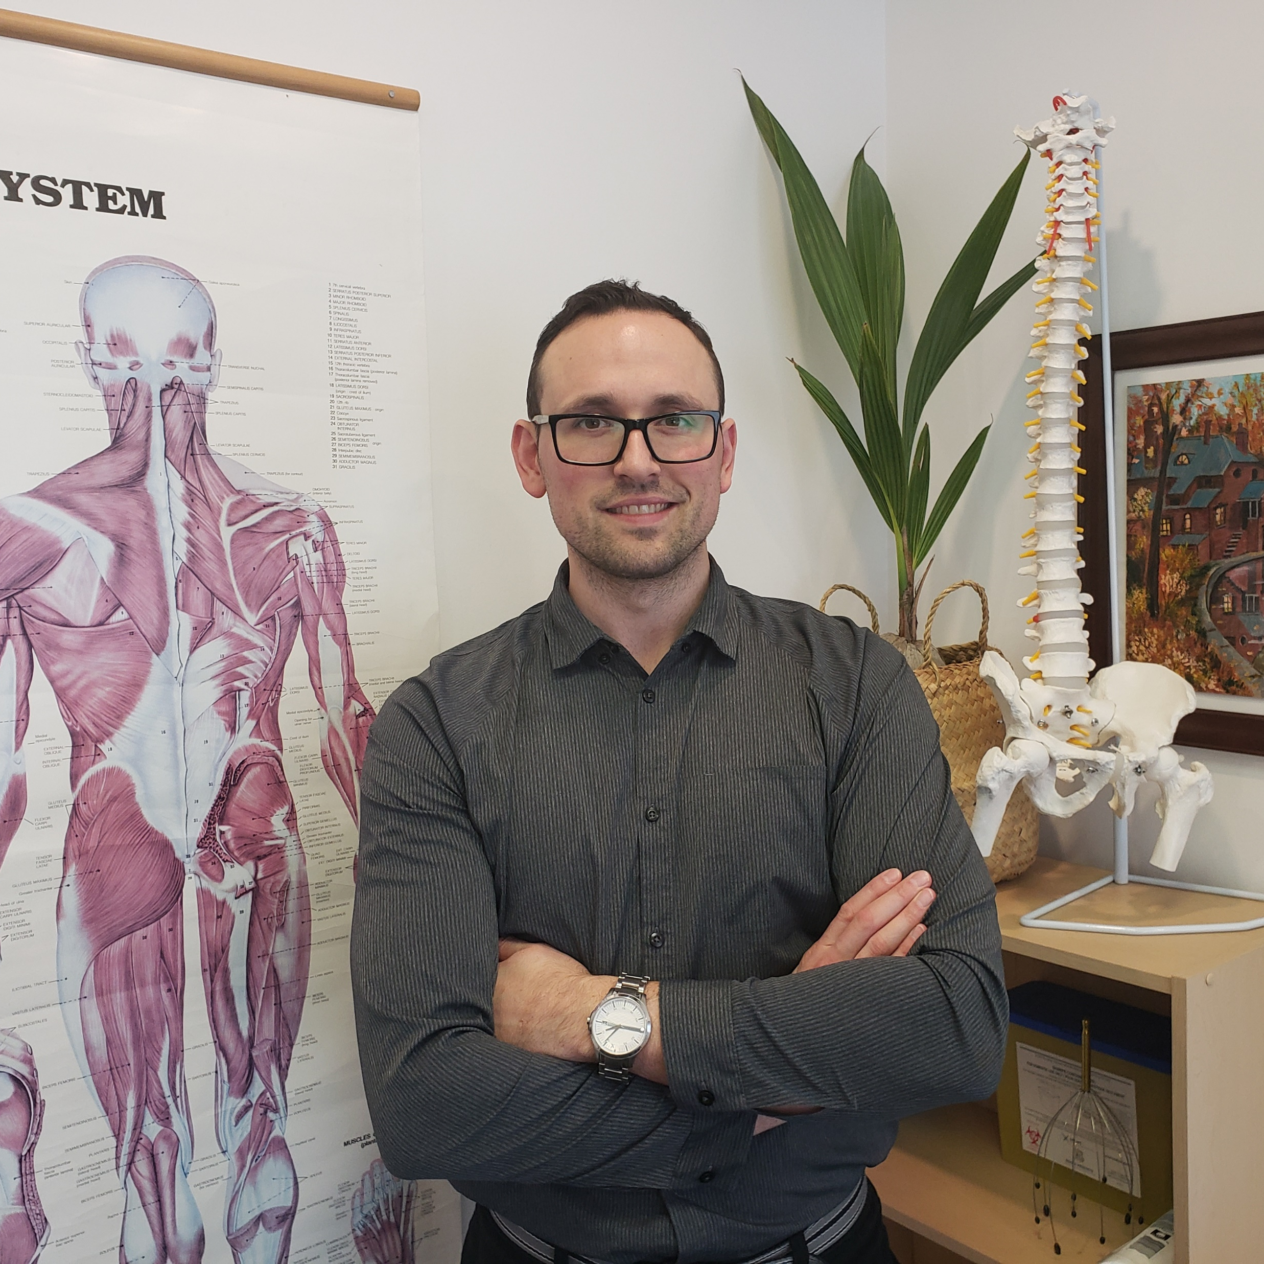
Alex Gurba PT
Bachelor of Science in Kinesiology from York University
Master of Science in Physiotherapy from McMaster University
Instructor at the University of Toronto Medical School (“Low Back Pain: A Syndrome Approach” second year class)
Established Gemini Health Group in Richmond Hill – A clinic designed to spread to knowledge of health and wellbeing to the community

Slide 3
On The Agenda
Ideal ergonomics when working from home
Self-management strategies for dealing with neck, back and other types of pain
When to seek help, and what kind of help we should be seeking
The financial impact of pain and disability on employers and the economy

Slide 4
Mechanical vs Non-Mechanical Pain
Mechanical pain reacts to our positions and movements
Affects all Musculo-skeletal structures
It is the pain that we can impact through ergonomics, movement and exercise
– 90% of ALL back pain
Non-mechanical pain does not react to our positions and movements – e.g. infections, inflammatory diseases

Slide 5
Working From Home is Here to Stay
According to StatCan:
  Almost 40% of Canadians are able to work from home
  From 2000-2018 increased very slowly from 10% to 13% - lots of unused capacity
  39% in last week of March 2020
  Canadian economy quick to adapt
  https://www150.statcan.gc.ca/n1/pub/45-28-0001/2020001/article/00026-eng.htm

Slide 6
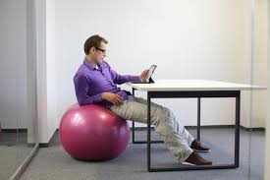
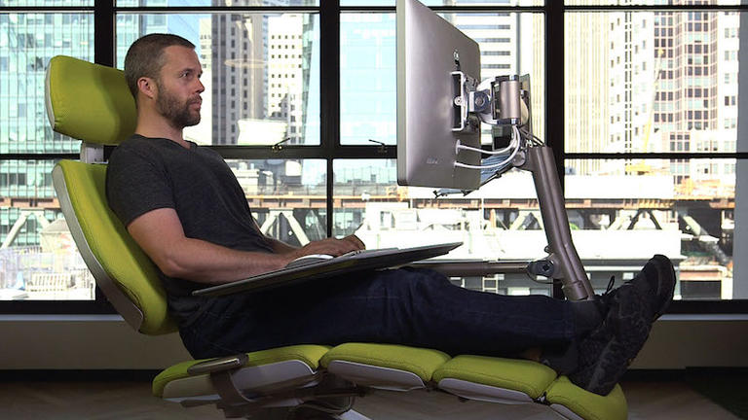
Ideal Ergonomics When Working From Home
Which one of these guys is going to need some treatment soon?
Hint: Its not him

Slide 7
The 5 Things That Will Reduce Pain When Working From Home
1) Use the backrest of your chair
2) Raise your monitor, bring it closer / make it bigger
3) Change positions
4) Take breaks
5) Keep moving

Slide 8
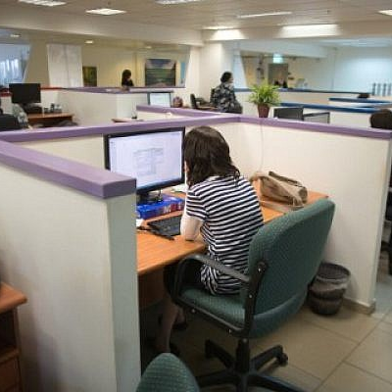
Use The Backrest of Your Chair
The most expensive chair can’t help if you don’t use the backrest
Goal of good posture is to be in a good ergonomic position without having to work for it
The backrest is there to let your back rest!

Slide 9
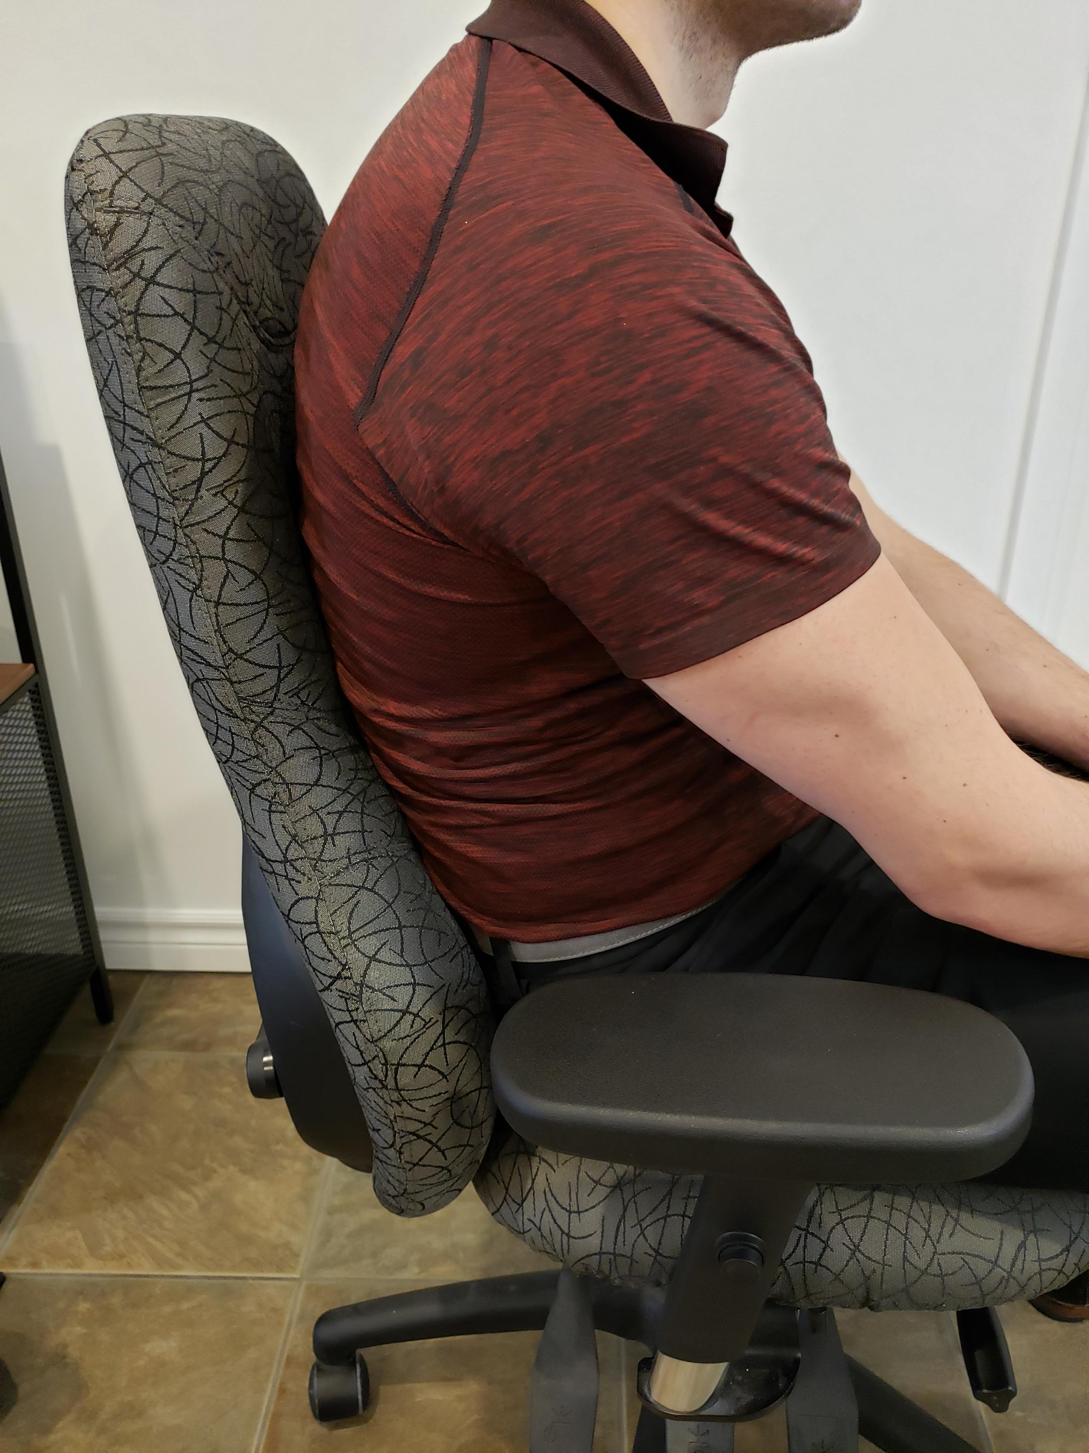
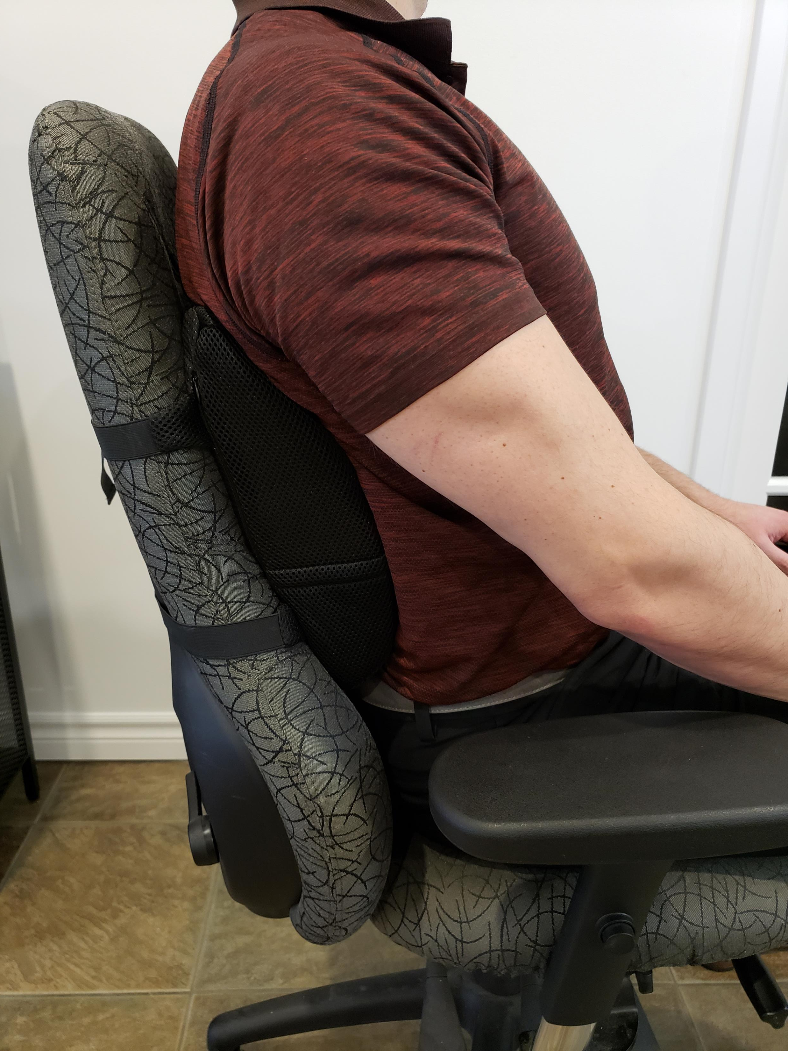
Lumbar Support
Placement is key – above buttock
Comfortable AND supportive
Helpful but not essential

Slide 10
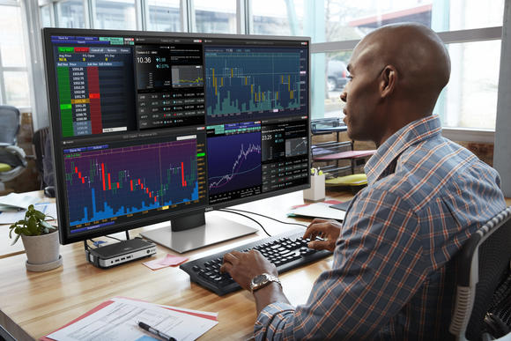
Raise Your Monitor,
Bring it Closer / Make it Bigger
Eyes at mid-screen level
About 2 feet away
Riser and an external mouse and keyboard for laptop
Use TV as monitor

Slide 11
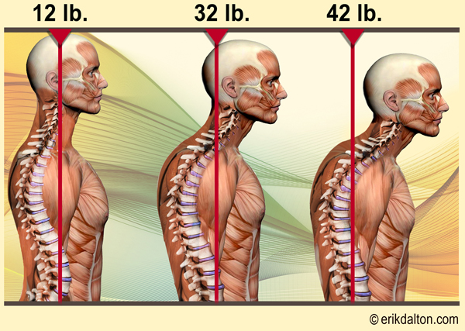
The Weight of The Head
Understand the WHY
Weight of head increases as we slouch
No wonder your neck and shoulders feel like rocks
Reduce leaning forward

Slide 12
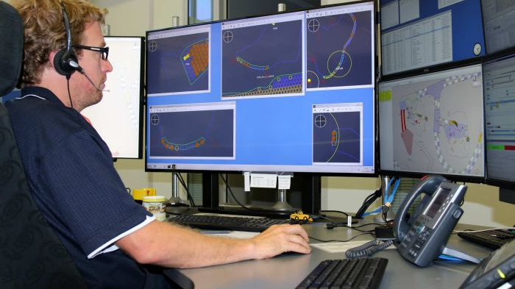
Ultimate Position Utilizing These Strategies

Slide 13
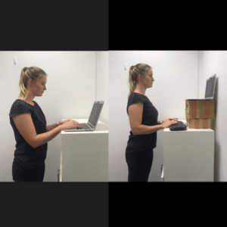

Change Positions
Or even lying down
Work in standing

Slide 14
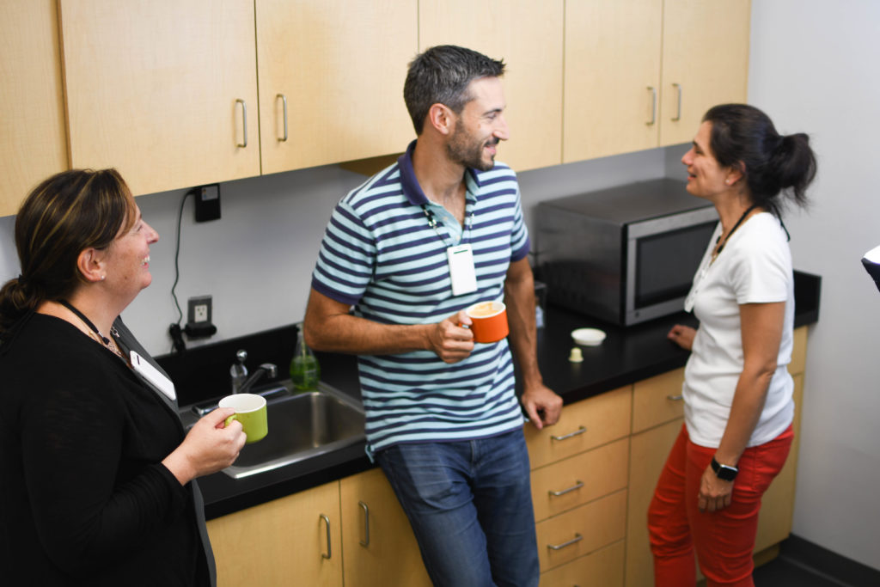
Take Breaks
Much harder than it sounds when working at home
Missing the “water-cooler talk”

Slide 15
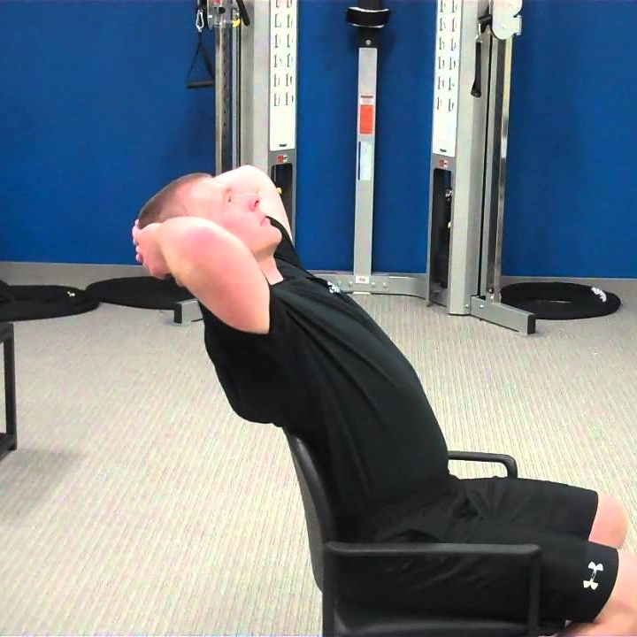
Keep Moving
Even the best ergonomic position will hurt eventually
Movement is the ultimate key to staying pain free and healthy at work
Stretch backward to balance out natural forward positions/moves

Slide 16
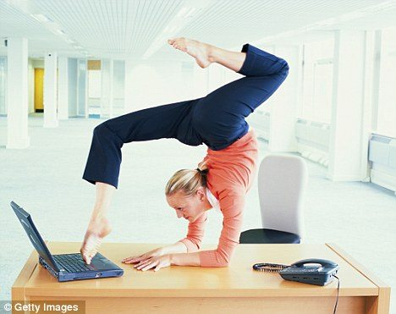
Self-Management Strategies when dealing with neck, back and other types of pain
Circ-De-Soleil at your desk not required

Slide 17
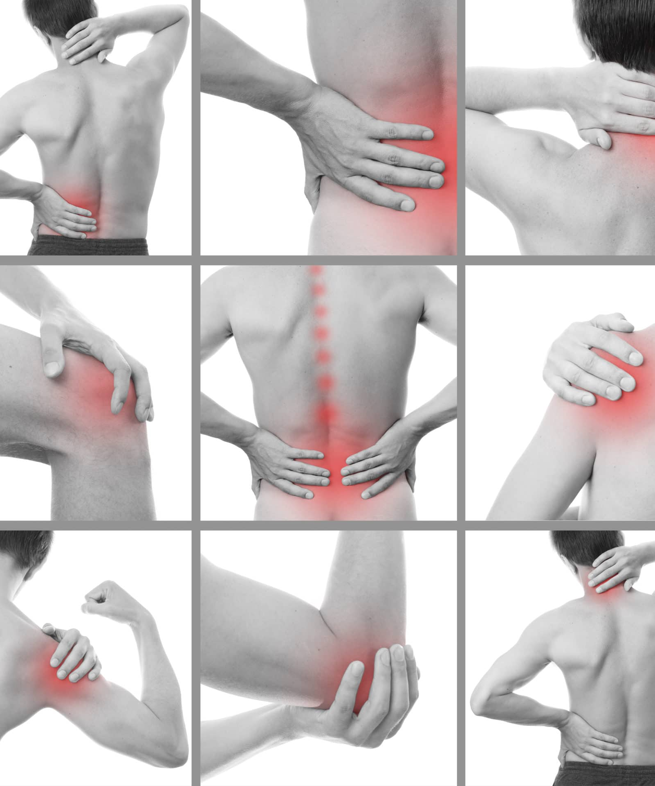
Where is My Pain Coming From?
Many pains are insidious - do not stem from “traumatic injury”
Many injuries come from “new use” not “overuse”

Slide 18
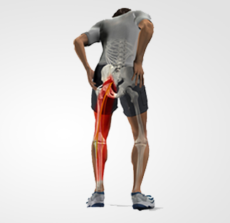
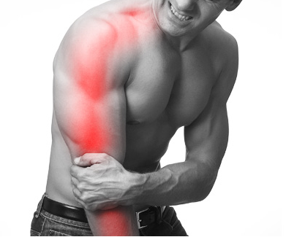
Radiculopathy –
Pain in Extremities Stemming From Spine
Radiculopathy can mimic
  tennis elbow
  carpal tunnel
  hamstring tightness
  calf pain and many more common conditions
Radiculopathy often presents with
  non-pinpoint
  broad area pains
  Numbness
  tingling

Slide 19
What Can I Do?
Move in many directions
Address the pain with movements (if tolerated) or positions (if all movements aggravate)
Use ice appropriately – can be very potent
Medication if needed…but carefully
  Prolonged NSAID use can be harmful

Slide 20
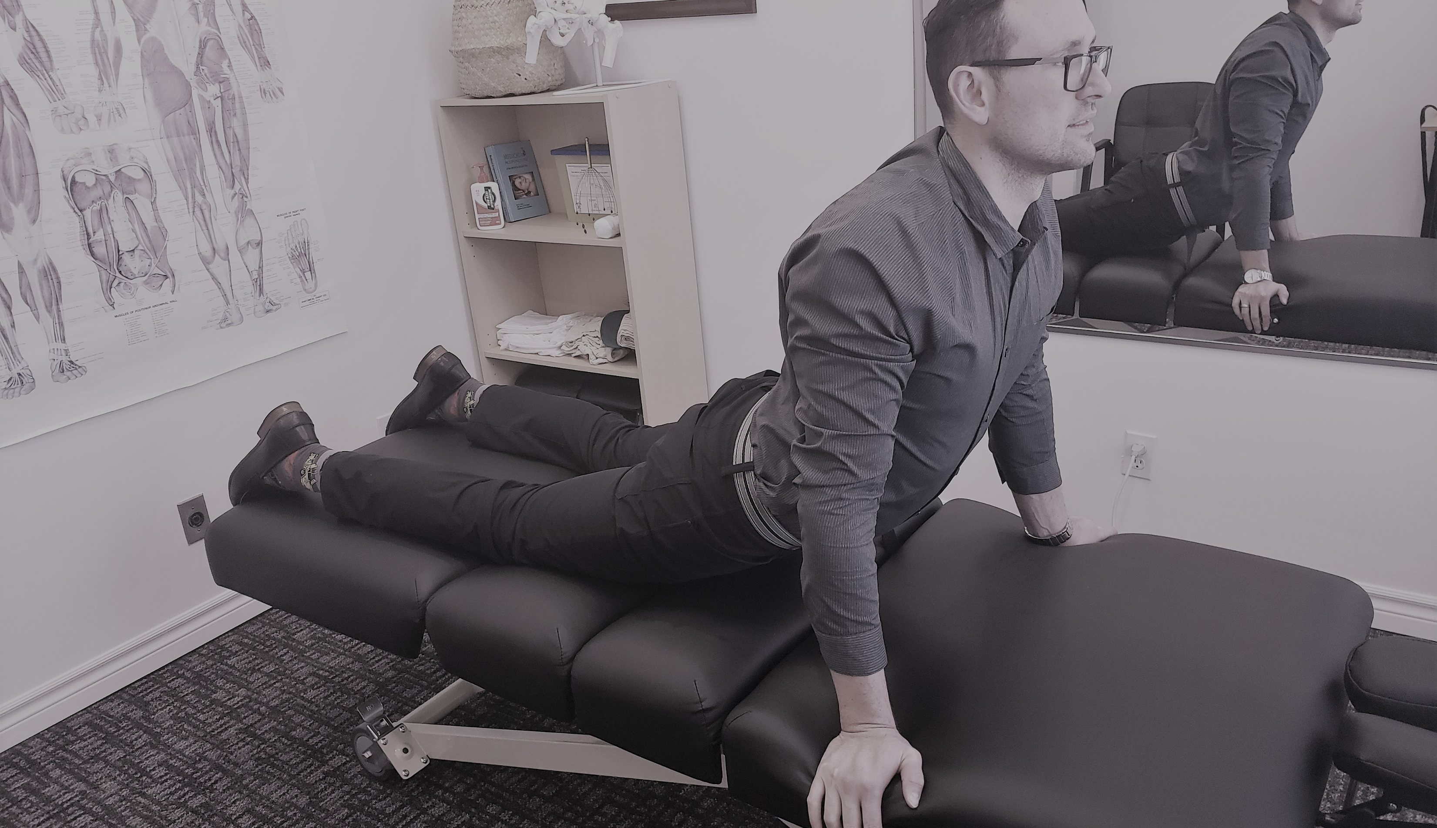
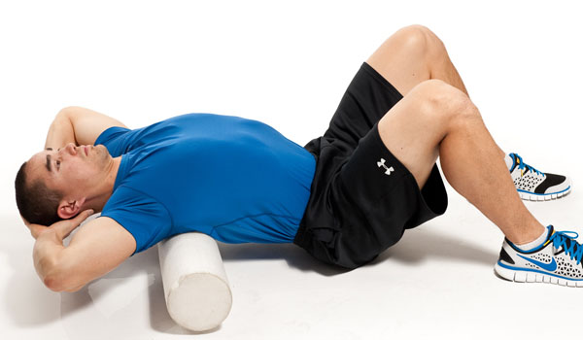
Best Movements To Reduce Pains
Reverse the pressures that occur with sitting
Sloppy push-ups / repetitive back extensions
Upper back extensions with neck retractions
Movements should be light and repetitive

Slide 21

Don’t Shy Away From Cracks
Our understanding of ‘cracking’ has changed dramatically
Recurring neck and back ‘cracks’ are not bad!
  They represent movement of a stiff joint
Don’t be afraid of them - they are not harmful
Prolonged immobility = joint stiffness = cracks

Slide 22
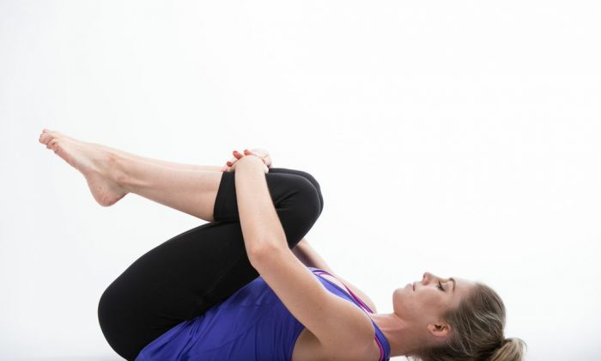
Look Up Stretches and Exercises Online
Err on the side of pain free movements
Aim for exercises that feel good right where your pain is
Don’t be afraid to try different exercises
What doesn’t hurt you at the time won’t harm you!

Slide 23


Slide 24
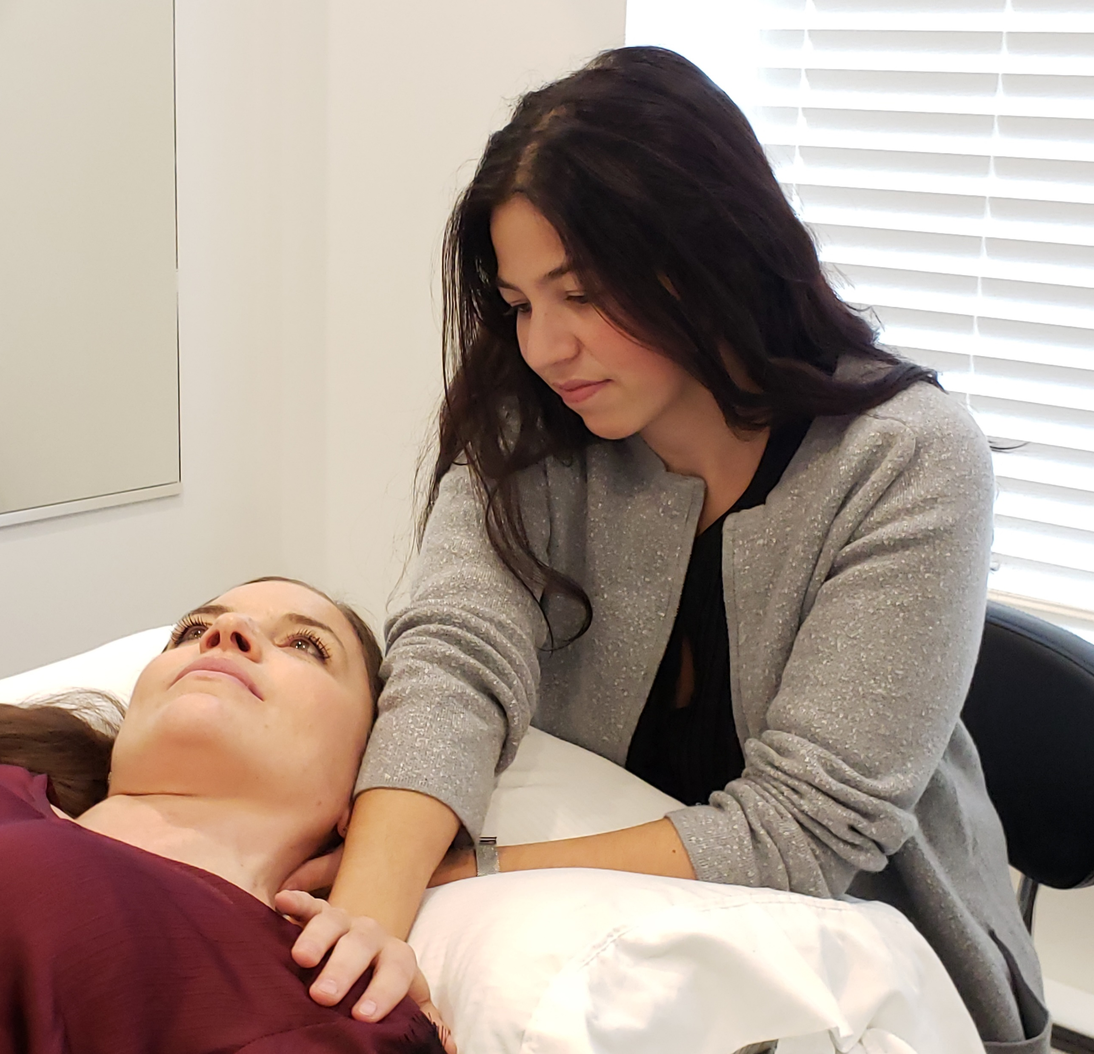



When To seek help, and what kind of help we should be seeking

Slide 25
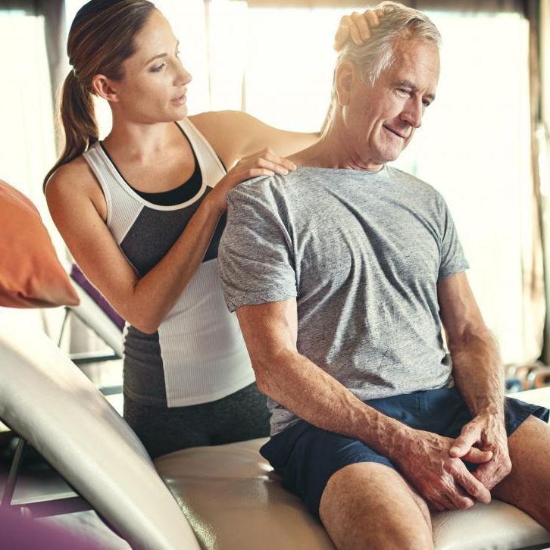
When Do I Stop Trying To Fix It Myself?
Non traumatic aches and pains that are not gone in a couple of days
Our day-to-day life caused the pain
Time is not on our side
A good therapist can speed up the recovery just by educating

Slide 26

Who Should I Go See? Who Is The Best?
Any therapist that will teach you how to take care of yourself
Fancy gadgets = $ not healthcare
Quick results + Long term solutions

Slide 27
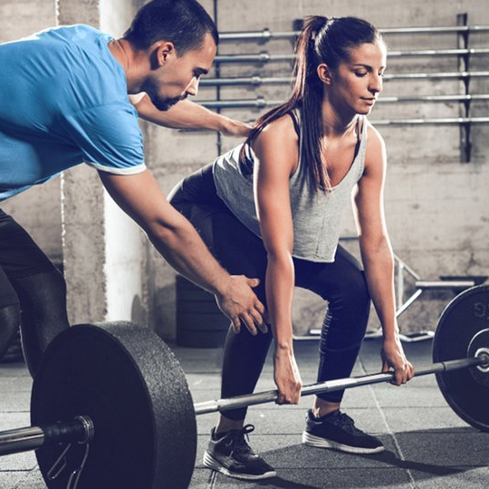
Results Are Not Instantaneous, Or Free
You only get one body – invest in it
Some attention now will save you a LOT of treatment later
Put in preventative work

Slide 28

The financial impact of pain and disability on employers and the economy

Slide 29

Employees in Pain Are Expensive
Cost of chronic pain in US alone is $560 billion (not including presenteeism)
Investing in pain education and preventative care pays off
Employees in pain = bad environment and low quality work

Slide 30

Investing in Employees’ Health
Patients less likely to seek help if they have to pay for it
Health insurance = Preventative care
Feeling supported is priceless

Slide 31
Final Words
Don’t fit yourself into your environment – fit your environment to YOURSELF
Movement is key…ideally in the opposite direction of how you sit
Seek help to learn + speed up recovery
Pain costs everyone – but employers can help

