Slide 1


Tackling Financial Anxiety During the COVID-19 Pandemic

Slide 2
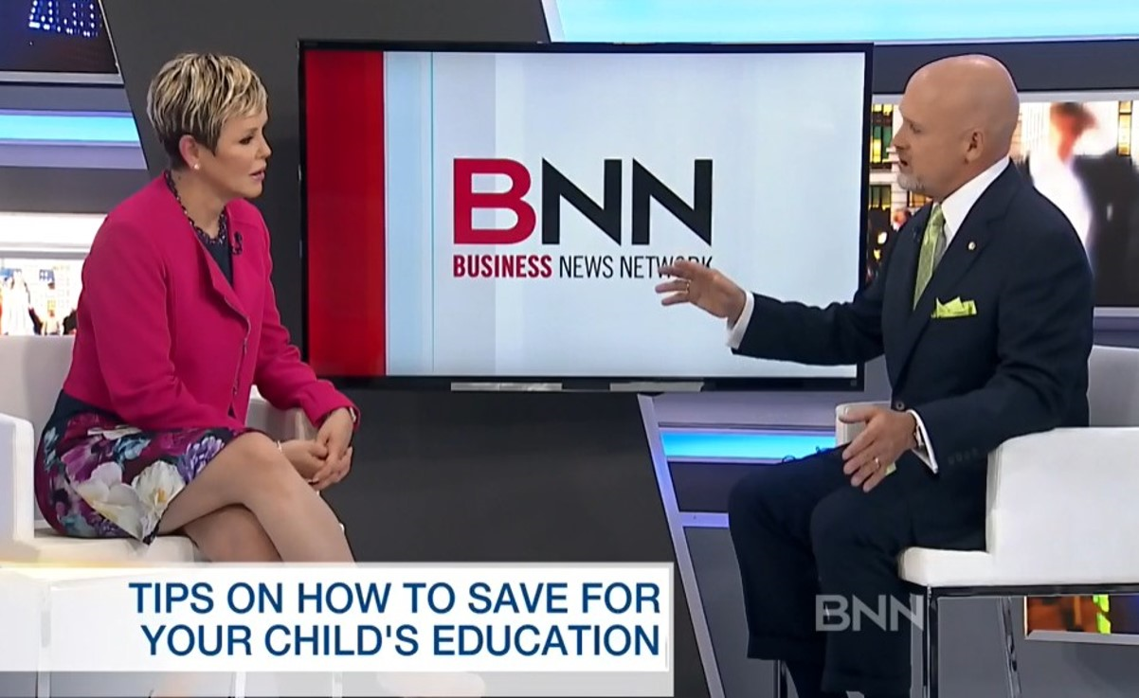
Mark Coutts
MBA CFP CLU CHS RPA CFDS FCSI
Author and speaker
Certified financial planner
Interviewed by national & local media
25+ years’ experience in wealth management

Slide 3
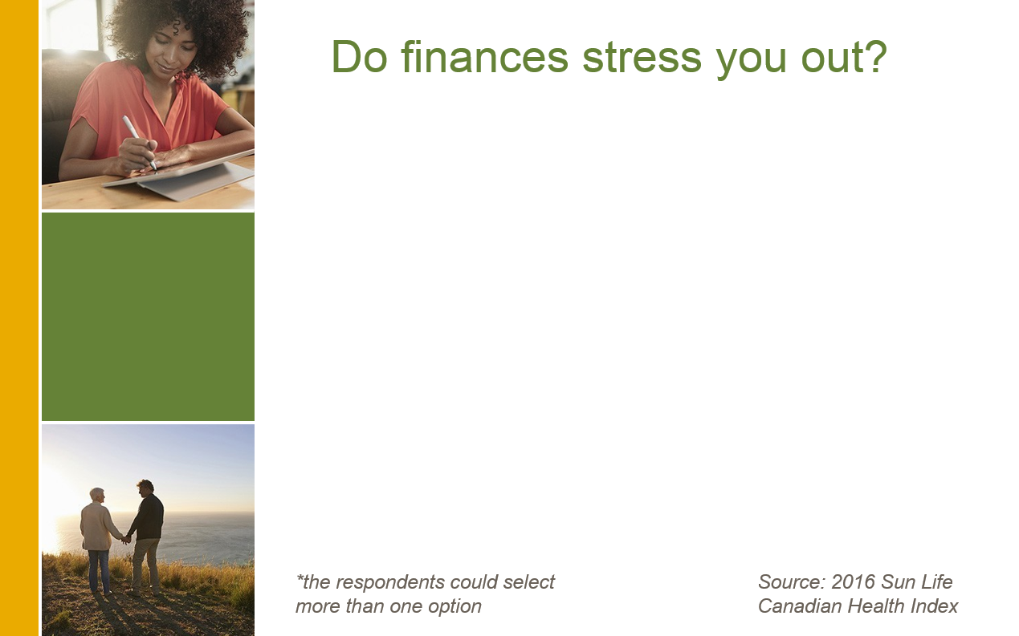
Financial stress is common
3 of the top 4 stress triggers have to do with money
4. health

Slide 4
What’s your investment bias?
Recency
Loss Aversion
Herding

Slide 5
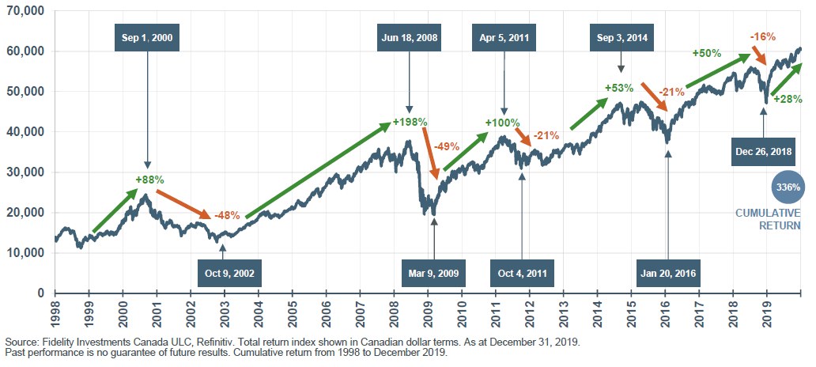
What goes down, will go up

Slide 6
Practice “emotional distancing” from your portfolio
Step back from the news & the noise
Don’t second-guess your long-term plan
A paper loss is not a real loss
Don’t trade market risk for inflation risk
Let the fund managers do what they do best

Slide 7
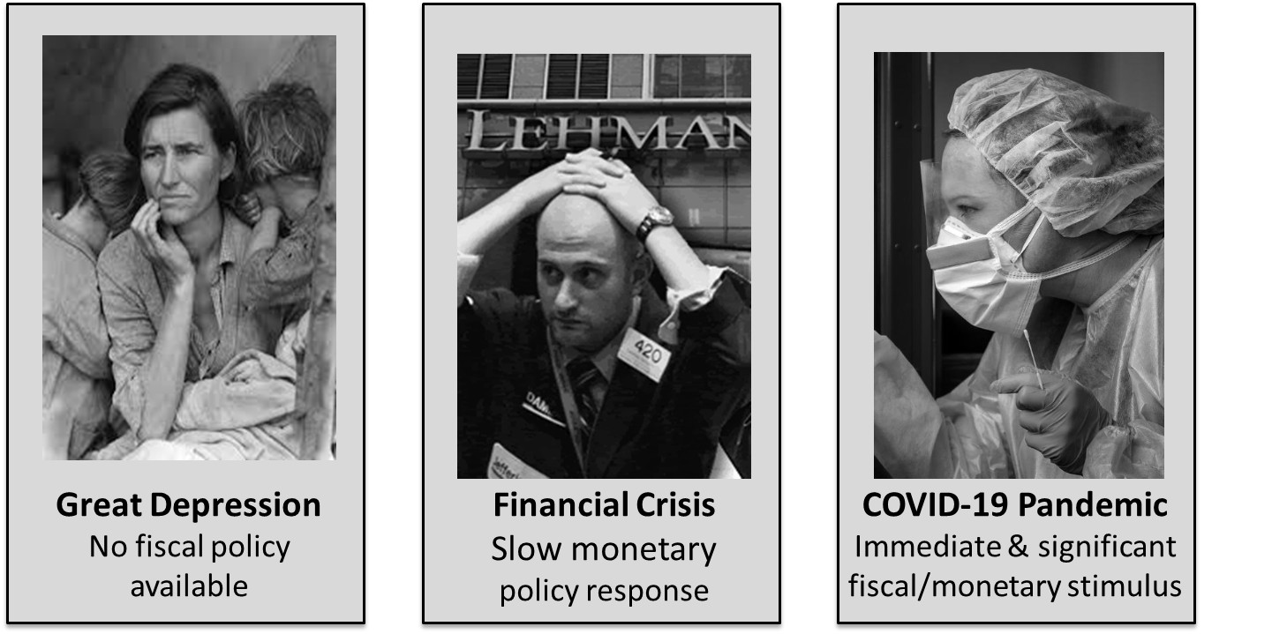
What’s different this time around

Slide 8
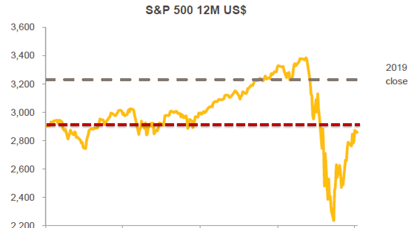
The stimulus bounce

Slide 9
Focus on current cash flow
Suspend contributions to RRSPs, TFSAs & RESPs
Switch variable mortgage & LOC payments to interest-only
Trigger automatic premium loan feature on permanent life insurance

Slide 10
Reasons to feel better
You planned for this
History does repeat itself
You’re paying others to do something so you can afford to do nothing
Count your sources of cash
  Government support
  Savings/chequing account
  TFSA
  Line of credit

Slide 11

Investors 5+ years from retirement
Minimal long-term impact
Your portfolio has ample time to recover
An excellent buying opportunity, especially with ongoing contributions

Slide 12

Investors <5 years from retirement
Implement a “cash wedge” strategy
Retirement is a feature film, not a snapshot
Review your retirement income plan with your advisor

Slide 13
Help for group plan members
Leverage the plan member resources available on your carrier’s web site
  Webinars/videos
  Articles
  Updates
For individual investors, talk to your financial advisor

Slide 14
Key Take-Aways
Don’t make rash decisions
Have a diversified portfolio, including cash
Stay calm and keep a long-term perspective
Seek professional guidance

