Slide 1
Telemedicine is here to stay
Mrigank Shail, MD
Medical Content Specialist, ACTO

Slide 2
Table of Contents
The history of telemedicine
Trends amid COVID-19 and what changes can we expect
Government and Private Industry involvement
How should employers prepare?

Slide 3

The history of telemedicine
1879 article in the Lancet talked about using the telephone to reduce unnecessary office visits
Notes:
The Lancet actually suggested using telephone to reduce office visits
The telephone was still new back then. And the idea did seem a bit unorthodox. And was considered very new age back then.

Slide 4
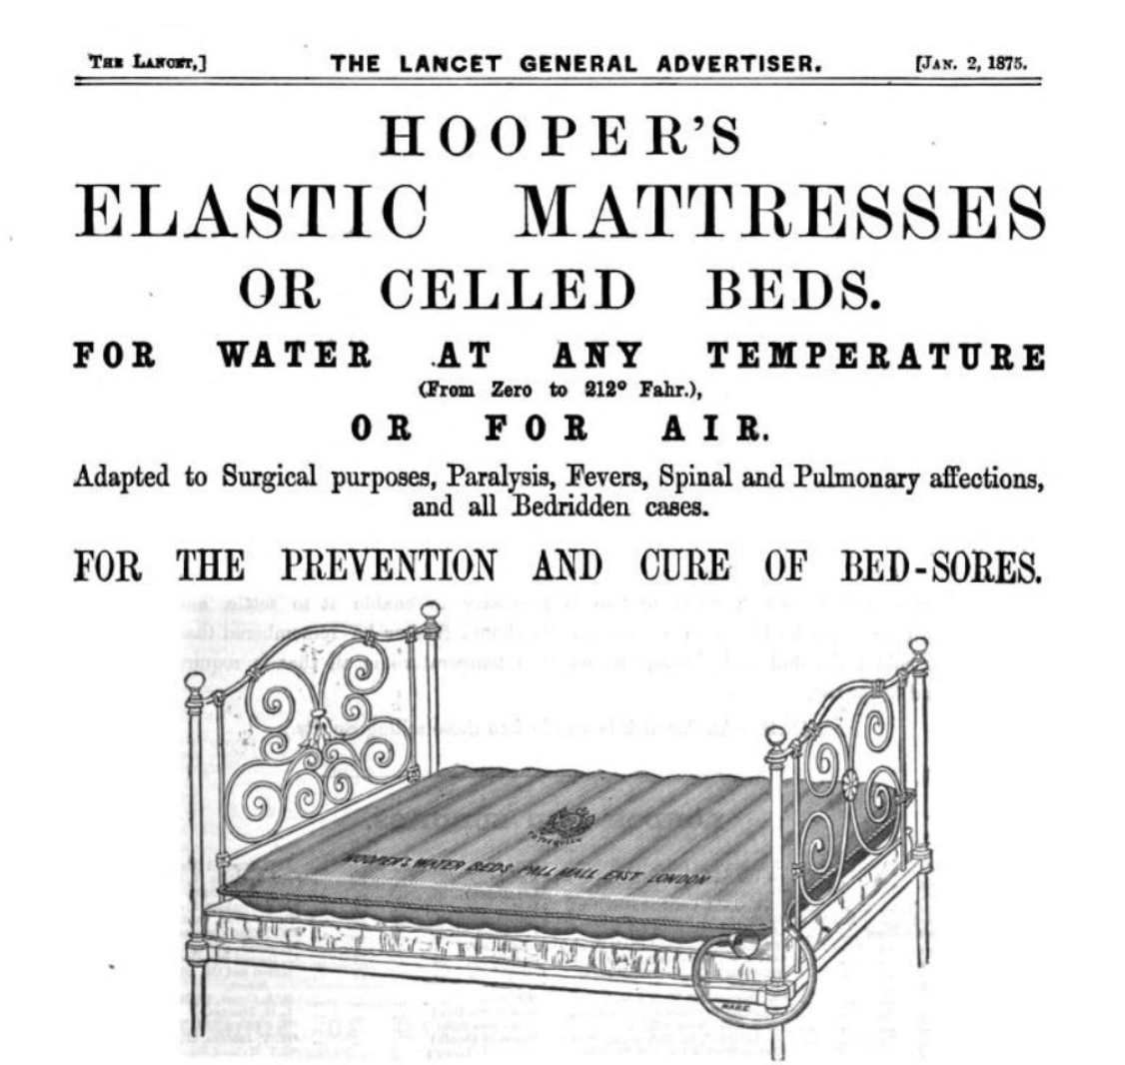
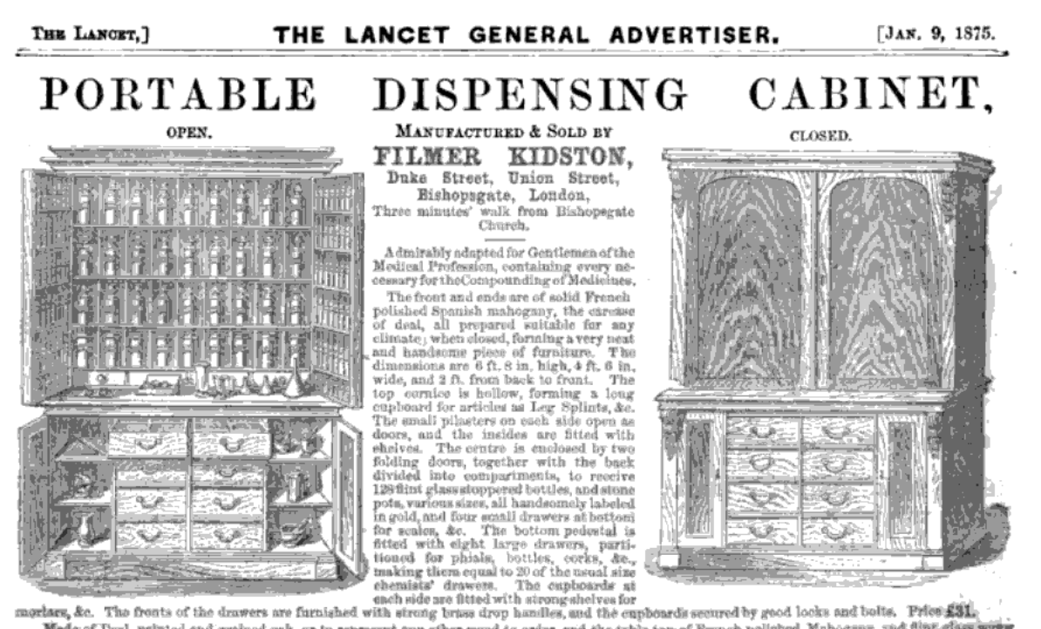
The lancet

Slide 5
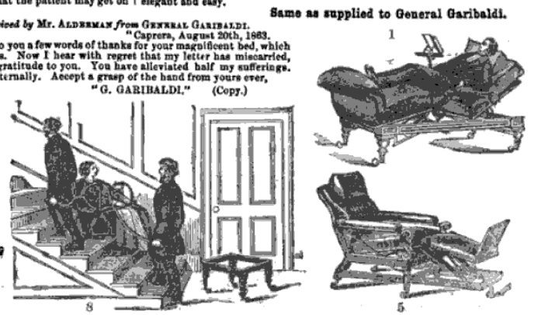

The Lancet
Notes:
They actually were more like a sear catalogue, and were full of ads.

Slide 6
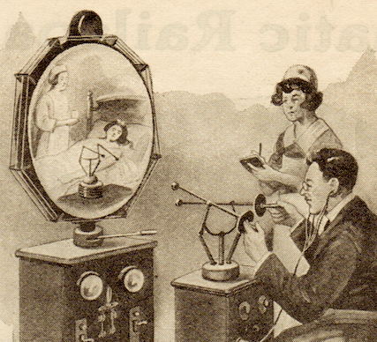
The history of telemedicine
In 1925, a cover of Science and Invention magazine showed a doctor diagnosing a patient by radio, and within envisioned a device that would allow for the video examination of a patient over distance.
Gernsback’s device was called the “teledactyl” and would allow doctors to not only see their patients through a viewscreen, but also touch them from miles away with spindly robot arms.
Notes:
This was a theoretical concept but it was way ahead of its time.

Slide 7
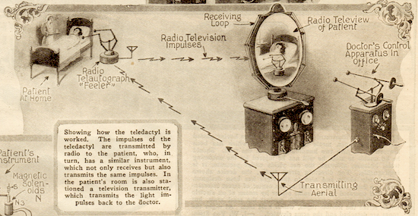
The history of telemedicine
Notes:
Here Grensback describes how teledactyl would work.

Slide 8

Dr. Maxwell House
In the 1970s, through the work of the late Dr. Maxwell House of the Memorial University of Newfoundland, Canada was at the forefront of virtual care development (House & Roberts, 1977).

Slide 9
Dr. Maxwell House
At first it ran through analog telephone lines, then video hookups.
Canada's Hermes satellite, launched in 1976, included a module from the Memorial medical school
The province-wide system links 65 locations, including offshore drill ships and provided more than 1,000 consultations a month.

Slide 10
Dr. Maxwell House
Initiatives have included teleoncology, telenuclear medicine, obstetrical ultrasound and child telepsychiatry.
Distance health education included programs for diabetic patients and parents of deaf children.
One teleconference project, in 1982, connected all 16 medical schools in Canada.
Surveys and technical trials reached as far as the British Antarctic.

Slide 11
The history of telemedicine
BUT - no national framework to implement such virtual care successfully.
Even though the bulk of healthcare facilities use digital record keeping, and a majority of citizens have internet access, Canada lags in providing digital healthcare to Canadians.
According to the 2019 Commonwealth Fund International Health Policy Survey comparing 11 high-income countries, CANADA RANKED WORST in its capacity to offer online access to patients.

Slide 12
U.S.A. Virtual care
U.S.A.’s Kaiser Permanente system leads the world in digital healthcare by providing service to > 12 million members.
2016 Kaiser Permanente report, approximately half of all U.S. patient-healthcare interactions were virtual.
> 30 million secure digital messages, accompanied by 6.2 million telephone interviews and almost 100,000 video visits

Slide 13
Canada Virtual care
Canada’s Health Informatics Association 2015 report, there were approximately 400,000 telehealth video clinical sessions, symbolizing just 0.15% of the 270 million billable services
In 2019, the Ontario Telemedicine Network reported that more than 1 million clinical video events took place.
Notes:
However, that number still pales in comparison to the total volume of services provided by the province’s health insurance plan.

Slide 14
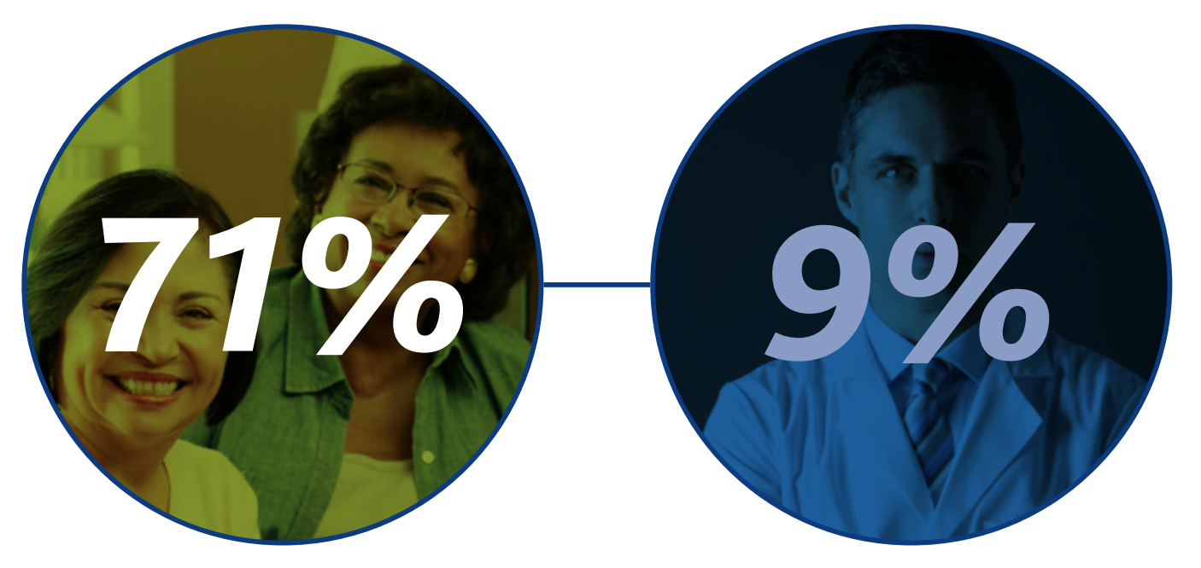
Canada Numbers
Canada Health Infoway
71% of Canadians would like to be able to BOOK APPOINTMENTS ELECTRONICALLY but just 9% of family physicians currently offer this option
Canada Health Infoway. Connecting patients for better health: 2018. Available: www.infoway-inforoute.ca/en/component/ edocman/3564-connecting-patients-for-better-health-2018/ view-document?Itemid=0 (accessed 2019 June 24).
Notes:
Recent surveys conducted by Canada Health Infoway (CHI) show a clear gap between the electronic access that patients would like to have and what physicians are currently offering.
According to Canada Health Infoway’s survey, there is a distinct gap between the digital access patients desire and what is currently being offered.

Slide 15
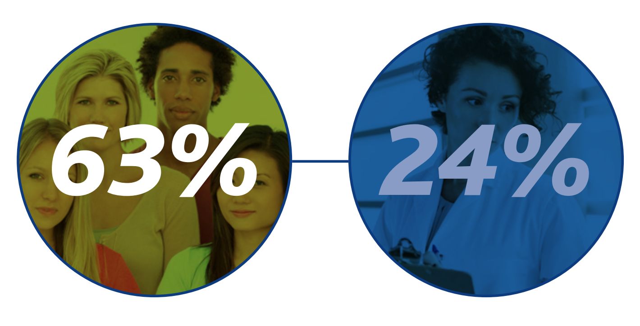
Canada Numbers
Canada Health Infoway
63% of Canadians would like to be able to EMAIL THEIR HEALTH CARE PROVIDER but just 24% of family physicians offer this service
Canada Health Infoway. Connecting patients for better health: 2018. Available: www.infoway-inforoute.ca/en/component/ edocman/3564-connecting-patients-for-better-health-2018/ view-document?Itemid=0 (accessed 2019 June 24).

Slide 16
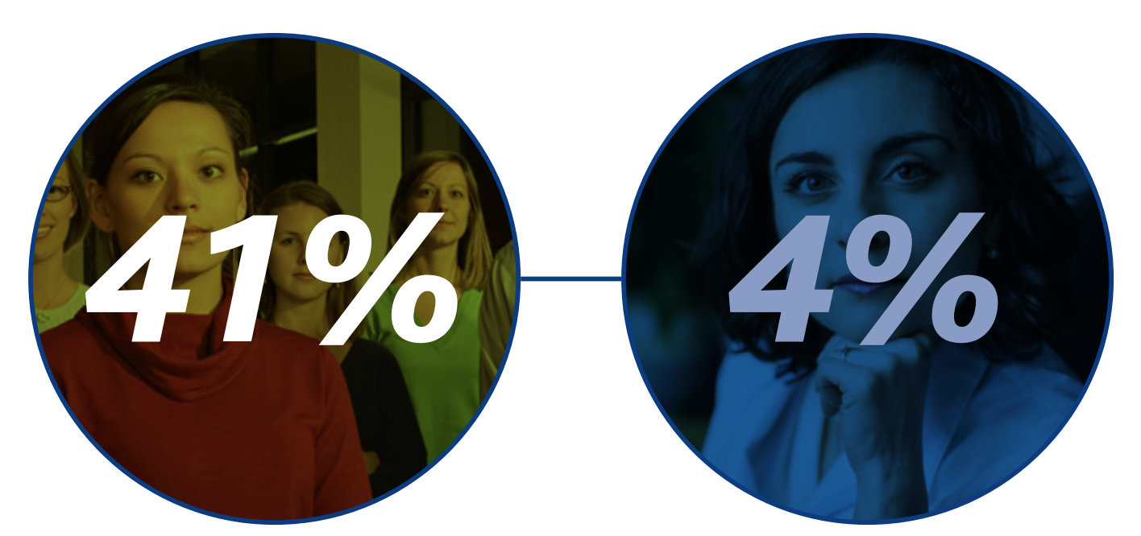
Canada Numbers
Canada Health Infoway
41% of Canadians would like have VIDEO VISITS with their health care provider but just 4% of family physicians offer this option.
Canada Health Infoway. Connecting patients for better health: 2018. Available: www.infoway-inforoute.ca/en/component/ edocman/3564-connecting-patients-for-better-health-2018/ view-document?Itemid=0 (accessed 2019 June 24).

Slide 17
Trends amid COVID-19 and what changes can we expect
80% of HCPs taking visits using telemedicine
400% increase in telehealth prescribers
950% increase in visits for patients 65+
IQVIA Monitoring the Impact of COVID
-19 on the Pharmaceutical Market
Published April 3, 2020
Data week ending March 20, 2020

Slide 18
Trends amid COVID-19 and what changes can we expect
Patient-Treatment Interaction
How patients get their treatments is changing
  Anxious patients attempting to fill meds early
  Prescription abandonment continues to decrease, as patients may be less price-sensitive and greater adherence during crisis
High growth, high volume therapeutic areas: Cardio, Nephro, Gastro, Obgyn, PED (due to their ease of shifting from face-to-face to telehealth)
IQVIA Monitoring the Impact of COVID
-19 on the Pharmaceutical Market
Published April 3, 2020
Data week ending March 20, 2020

Slide 19

Artificial intelligence in medicine

Slide 20

A.I. in PSYCHIATRY
WinterLight Labs
Developed algorithm to dx depression, Alzheimer’s, Frontotemporal Dementia (bvFTD) and Primary Progressive Aphasia (PPA)
Using Biometric with 82% accuracy

Slide 21
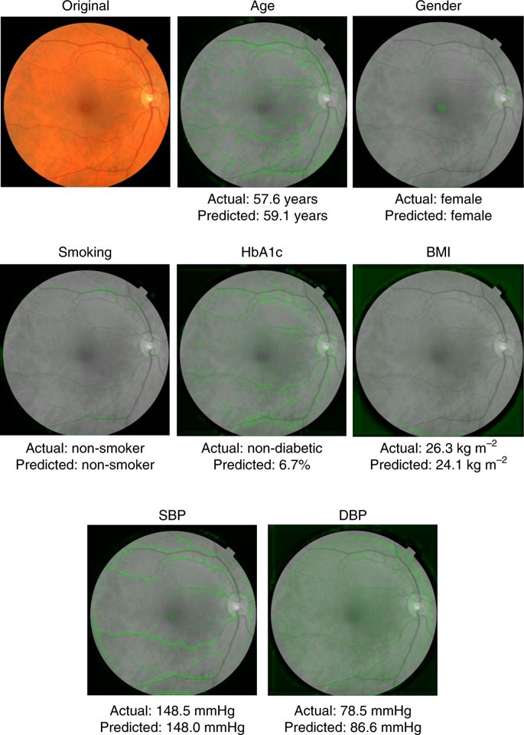

A.I. in internal medicine

Slide 22
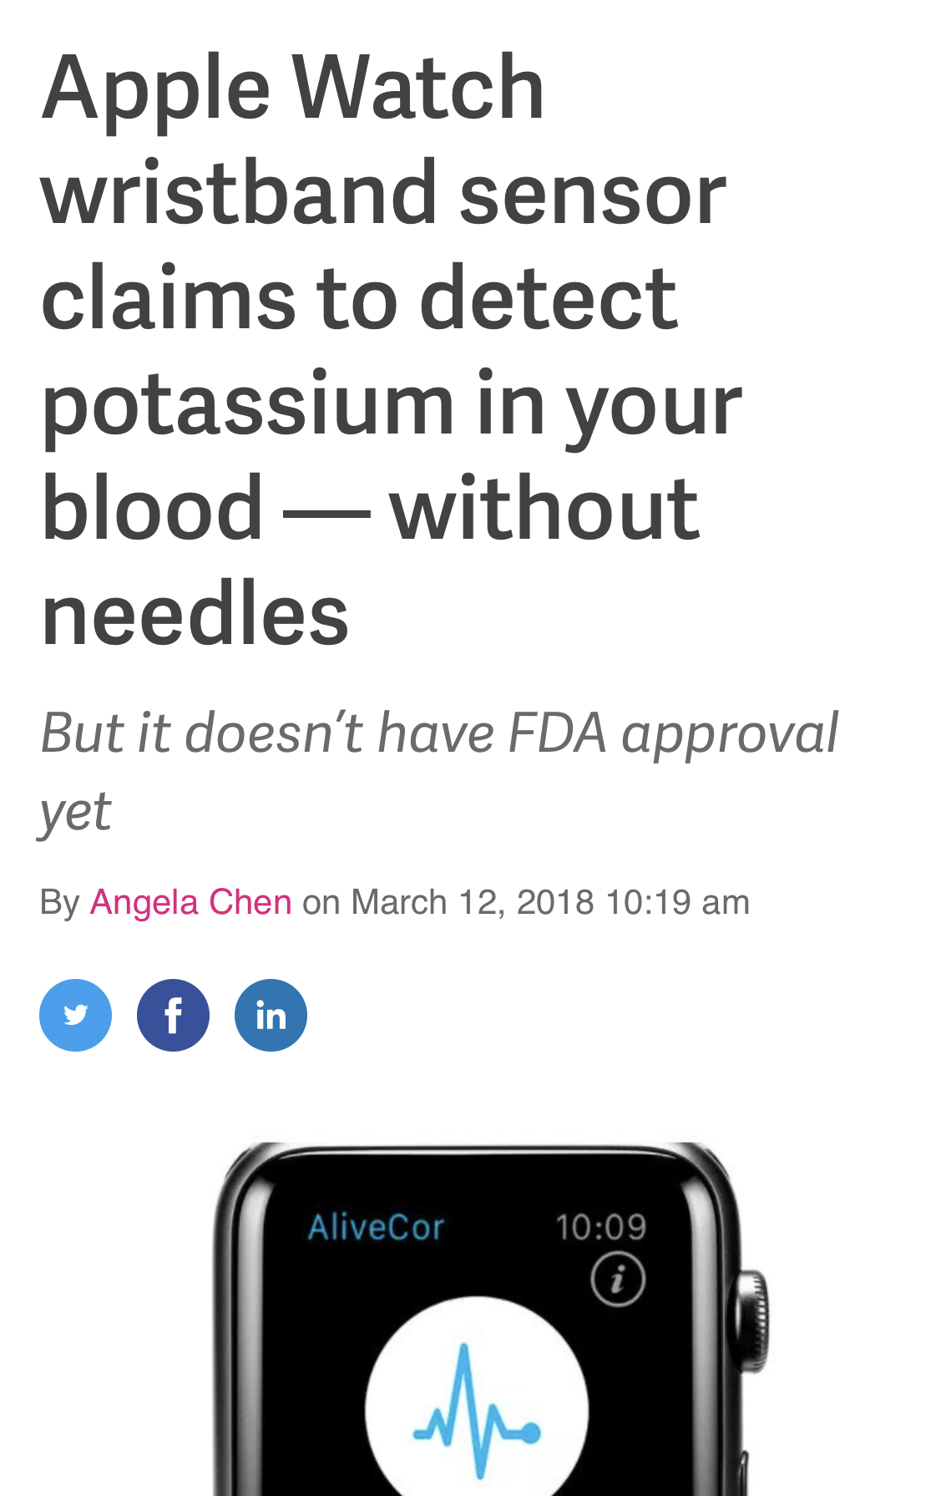

A.I. in Physiology

Slide 23
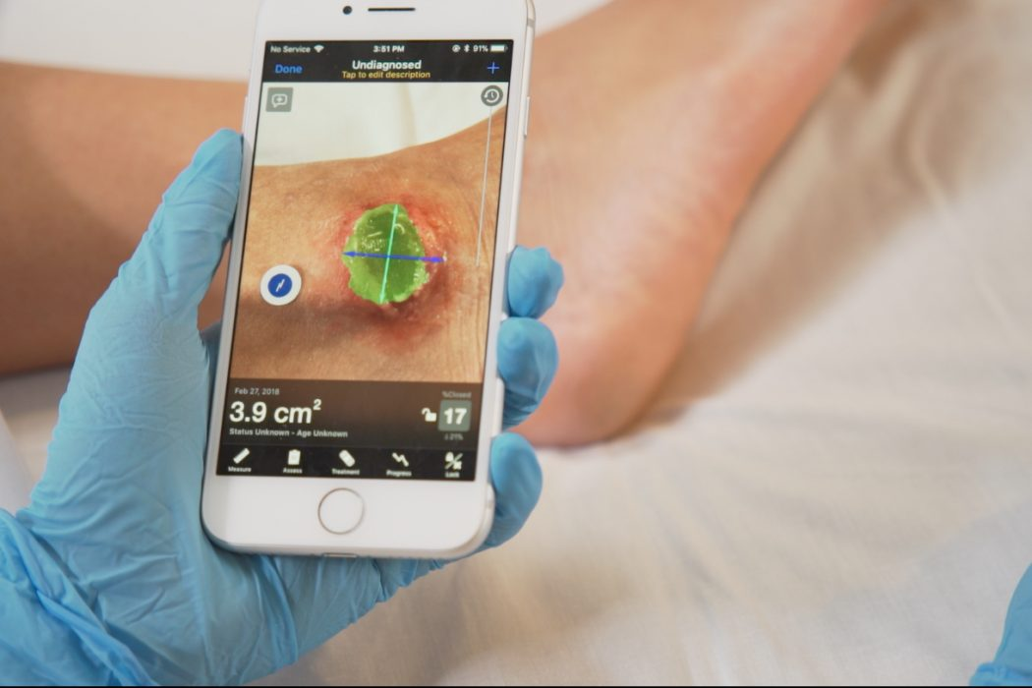
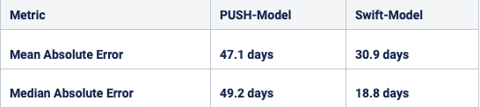
A.I. in WOUND CARE
SWIFT MEDICAL
Wound care app
Uses images to create wound care plan
Measurements are significantly more accurate
Notes:
These definitely don’t replace hospital visits. But they are augmenting healthcare and are reducing costs and burden on the Heath care system

Slide 24

Government involvement
The World Health Organization (WHO) has projected that there will a global shortage of 18 million health workers by 2030
WHO adopted a resolution on digital health that calls governments to assess their current and potential use of digital technologies for health
Notes:
WHO realizes that telemedicine is the cure for the future. They are taking this idea and running with it. Dr. Tedros ran on this platform. And they would like to provide universal heathcare to everyone. Telemedicine can be used to provide services to developing countries and developed countries very cheap.

Slide 25

Bring Canada up to speed
Virtual Care Task Force (VCTF)
Joint committee consisting:
  Canadian Medical Association
  College of Family Physicians of Canada
  Royal College of Physicians and Surgeons of Canada
Notes:
VCTF’s primary purpose is to conduct an exhaustive inquiry on Canada’s current state of virtual healthcare. Even though the distinct organizations of the committee serve physicians, the task force’s end goal is to promote quality care for patients. Therefore, the VCTF hopes its proposals will apply to all members of health care teams and will eventually help all Canadians.

Slide 26
VCTF involvement
The report defines virtual care as “any interaction between patients and/or members of their circle of care, occurring remotely, using any forms of communication or information technologies, with the aim of facilitating or maximizing the quality and effectiveness of patient care.” (Agarwal P et al.).
Notes:
CEO on OTN, Dr. Edward Brown, said “if you have a phone, then you are ready for telemedicine”. Its as simple as that.

Slide 27
Government REQUIREMENTS
Fitting virtual care into your practice
Technology requirements
Scope of practice — what problems can be safely assessed and treated
“Webside” manner
All encrypted and safe

Slide 28
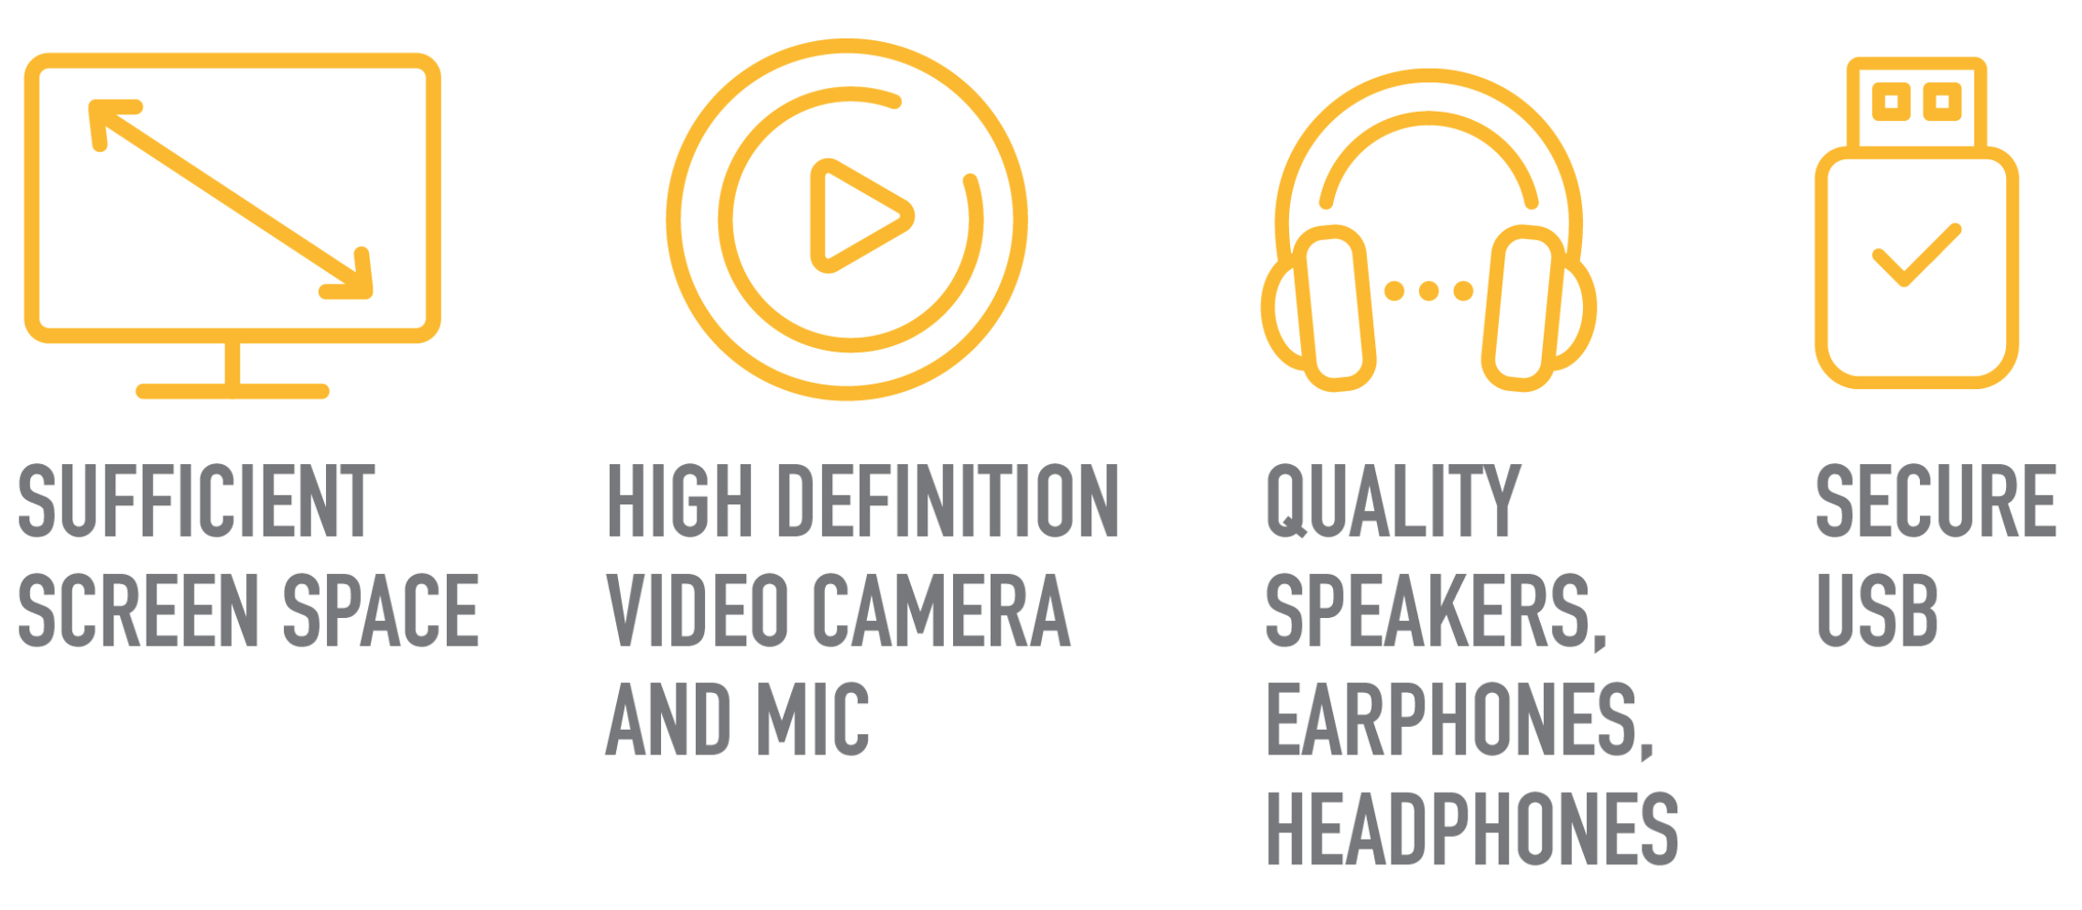
Government REQUIREMENTS

Slide 29
Government REQUIREMENTS
Telemedicine cannot replace physical exams and emergencies
Notes:
Not amenable to virtual care include any new and significant emergency symptoms such as chest pain, shortness of breath and loss of neurologic function.
They also include ear pain, cough, abdominal/gastrointestinal symptoms, musculoskeletal injuries or conditions, most neurological symptoms and congestive heart failure
These you must go into the clinic or ER where physicians will probably need to do invasive tests

Slide 30
Private industry collaboration
“Let us not re-invent the wheel,”
Dr. Yanick Beaulieu, a physician at the Montreal Heart Institute and the Founder and C.E.O. of Innovative Imaging Technologies
Private sector has already realized the healthcare shortcomings at hand. It is moving into virtual care by offering services directly to patients and employers for a fee.

Slide 31
Private industry collaboration
For a family membership cost of $50 per month, getmaple.ca offers assessments through online consultations, services of prescriptions, and sick notes.
A Quebec-based organization started by dermatologists permits patients to electronically send photographs of their skin problems and receive a diagnosis and prescription within 24 to 72 hours.
Great-West Life and Sun Life are now offering some coverage and employee benefits for these services.

Slide 32
Private industry collaboration
Capitalistic supply and demand = virtual care ubiquitous,
Government led Pan-Canadian framework = stabilize and preserve best practices
Integrated business models + regulated guidelines = Canadians get consistent services and the gold standard quality of care
Notes:
Private industries have already done the heavy lifting
Governments must now come in and provide guidelines and framework.

Slide 33
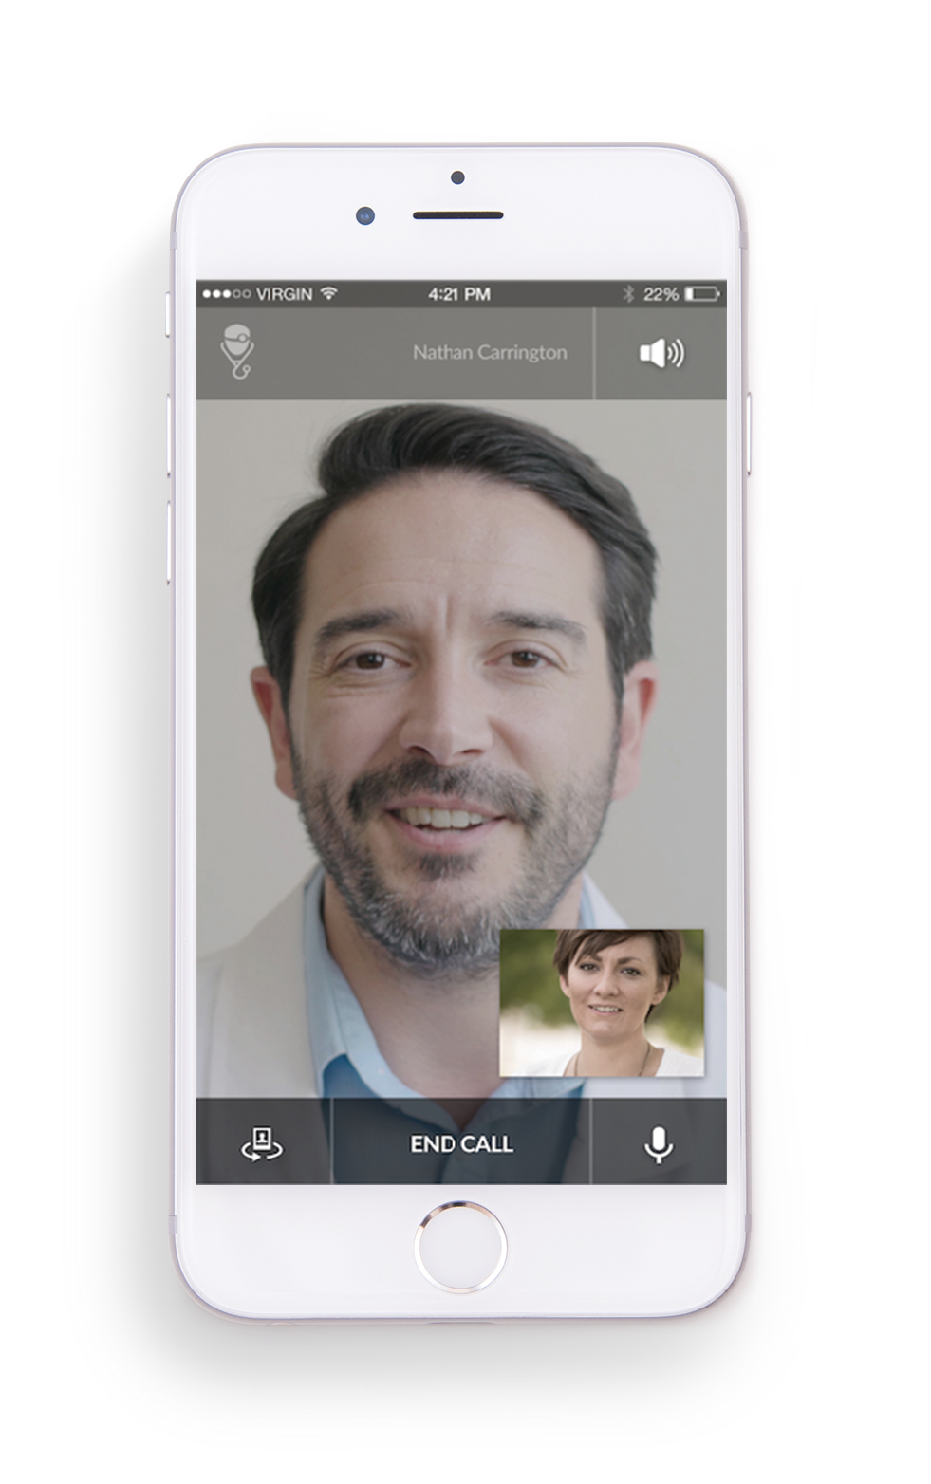
WHY & how should employers prepare?

Slide 34
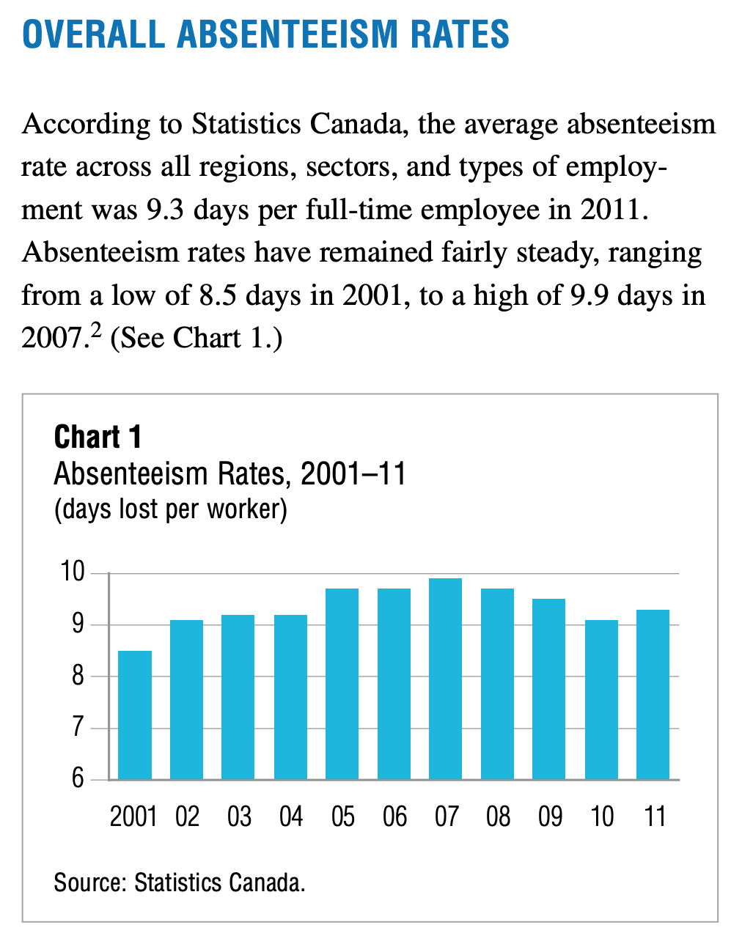
WHY should employers prepare?
In Canada, it can Cut Down on $2,000 of Losses Per Employee Annually
a) Employee absenteeism costs employers $16.6 billion each year
b) Reduce employee absenteeism and prevent future hospital visits
c) Immediate access to mental health services – employee well being
Notes:
Today more than ever, Canadian employees are enthused when their employer offers mobile virtual access to medical care, as the time saved is tremendous, and receiving high quality of care at the moment of need is invaluable.

Slide 35
WHY should employers prepare?
Virtual Healthcare Increases Workplace Productivity
A) The productivity of teams can drop by 22% when one member is absent
B) Healthy employees are more productive than peers with health issues
C) Employees with depression are 3X more likely to experience lost productivity
Mitchell, R. J., & Bates, P. (2011). Measuring health-related productivity loss. Population health management, 14(2), 93–98. https://doi.org/10.1089/pop.2010.0014
Notes:
Today more than ever, Canadian employees are enthused when their employer offers mobile virtual access to medical care, as the time saved is tremendous, and receiving high quality of care at the moment of need is invaluable.

Slide 36
CDC & J. Occup Environ Med
“In fact, indirect costs of poor health including absenteeism, disability, or reduced work output may be several times higher than direct medical costs”
“Productivity losses related to personal and family health problems cost U.S. employers $1,685 per employee per year, or $225.8 billion annually”
1. Partnership for Prevention. Leading by Example: CEOs on the business case for worksite health promotion. Washington, DC: 2005.
2. Stewart WF, Ricci JA, Chee E, Morganstein D. Lost productive work time costs from health conditions in the United States: results from the American productivity audit. J Occup Environ Med. 2003;45(12):1234-1246
3. https://www.cdc.gov/workplacehealthpromotion/model/evaluation/productivity.html

Slide 37
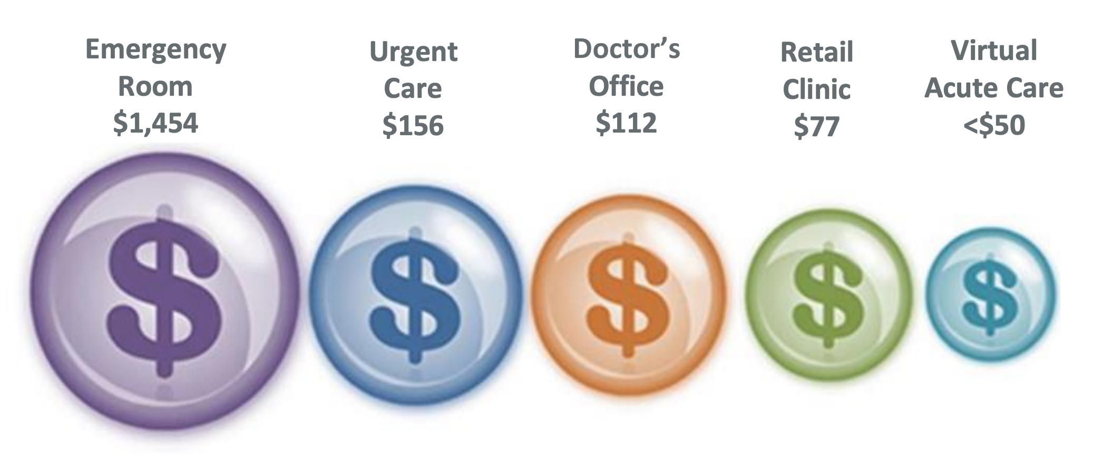
Benefits of Telemedicine for Employers
Increased productivity
Improved employee retention
Healthier employee population
Reduced health care costs

Slide 38
Benefits of Telemedicine for Employees
No travel costs
No unpaid time or no use of paid time off – Available 24/7
Reduced out of pocket costs
Ability to see trusted providers
Faster care – No need to wait for a scheduled visit
Notes:
Today more than ever, Canadian employees are enthused when their employer offers mobile virtual access to medical care, as the time saved is tremendous, and receiving high quality of care at the moment of need is invaluable.

Slide 39
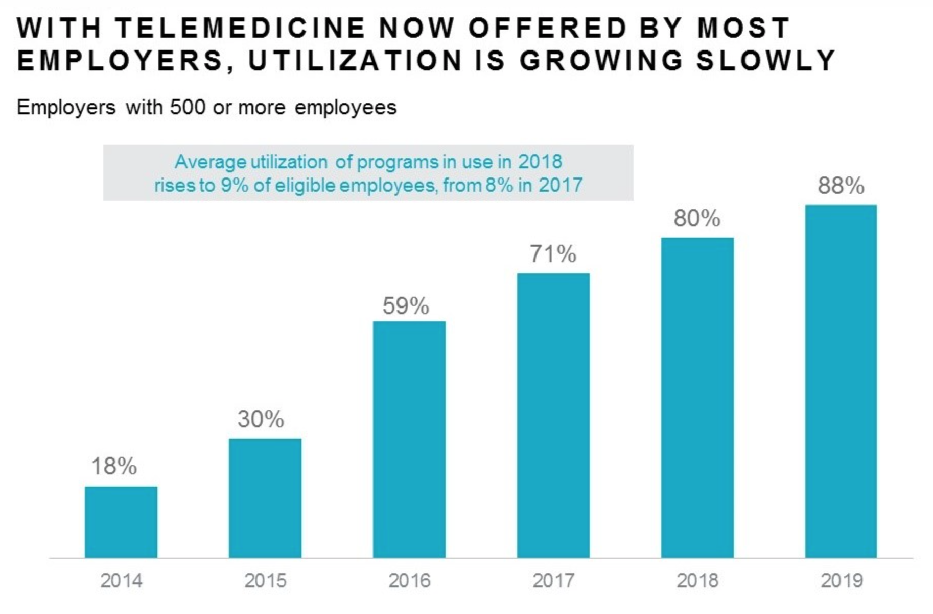
How should employers prepare?
The Mercer National Survey of Employer-Sponsored Health Plans
Notes:
The Mercer National Survey of Employer-Sponsored Health Plans is conducted using a national probability sample of public and private employers with at least 10 employees; 2,558 employers completed the survey in 2019. The survey was conducted during the summer, when most employers have a good fix on their costs for the current year. Results represent about 700,000 employers and about 124 million full- and part-time employees, with a margin of error of +/–3%.

Slide 40
How should employers prepare?
DRIVE EMPLOYEE INTEREST IN TELEMEDICINE
Save money – lower cost visit
Save time – less time required
Easy, convenient access to care

Slide 41
How should employers prepare?
Offering Telemedicine as an Employee Benefit
Apps/Web Only
Access to Telemedicine Clinic
Replace Onsite Clinic with Telemedicine
Notes:
Only telemedicine clinics = Appletree offers services
Onsite telemedicine clinic = kiosks
According to Mercer[ii], twenty-nine percent of employers with over 5,000 employees have onsite clinics. Yet onsite clinics can cost anywhere from $50,000 to nearly $700,000 annually to operate[iii] with full-time clinical staff, and typically can only serve employees in major locations. At just $15,000-$60,000, telehealth kiosks can extend the reach of existing onsite clinic staff to small- and mid-sized locations as well.

Slide 42
How should employers prepare?
Make it available to everyone
Leverage executive champions
Educate employees about the benefit
Offer incentives for enrollment
Provide a secure, private space
Measure, manage, and share the results

Slide 43
TELEMEDICINE REGULATED TOOLS
Maple
QHR
ARYA EHR
TELUS Health EMR
Zoom.us
Microquest's dr2dr Secure Messaging
Brightsquid Secure-mail
Think Research Virtual Care

Slide 44
Dr. Yanick Beaulieu
Panel guest and contributor to the VCTF study
Video

Slide 45
Telemedicine is here to stay
Post COVID era can be used to solidify virtual care implementation tools
We need to be proactive rather that reactive
More tools, more companies ready to provide platforms
Patients have finally experienced telemedicine and are ready

Slide 46

Thank you
Questions

